Slide 1

Research Meeting
Maggie Huang
Prof. Elisa Bertino
May 2, 2024

Slide 2

May 2, 2024
Incoming Deadlines

Slide 3
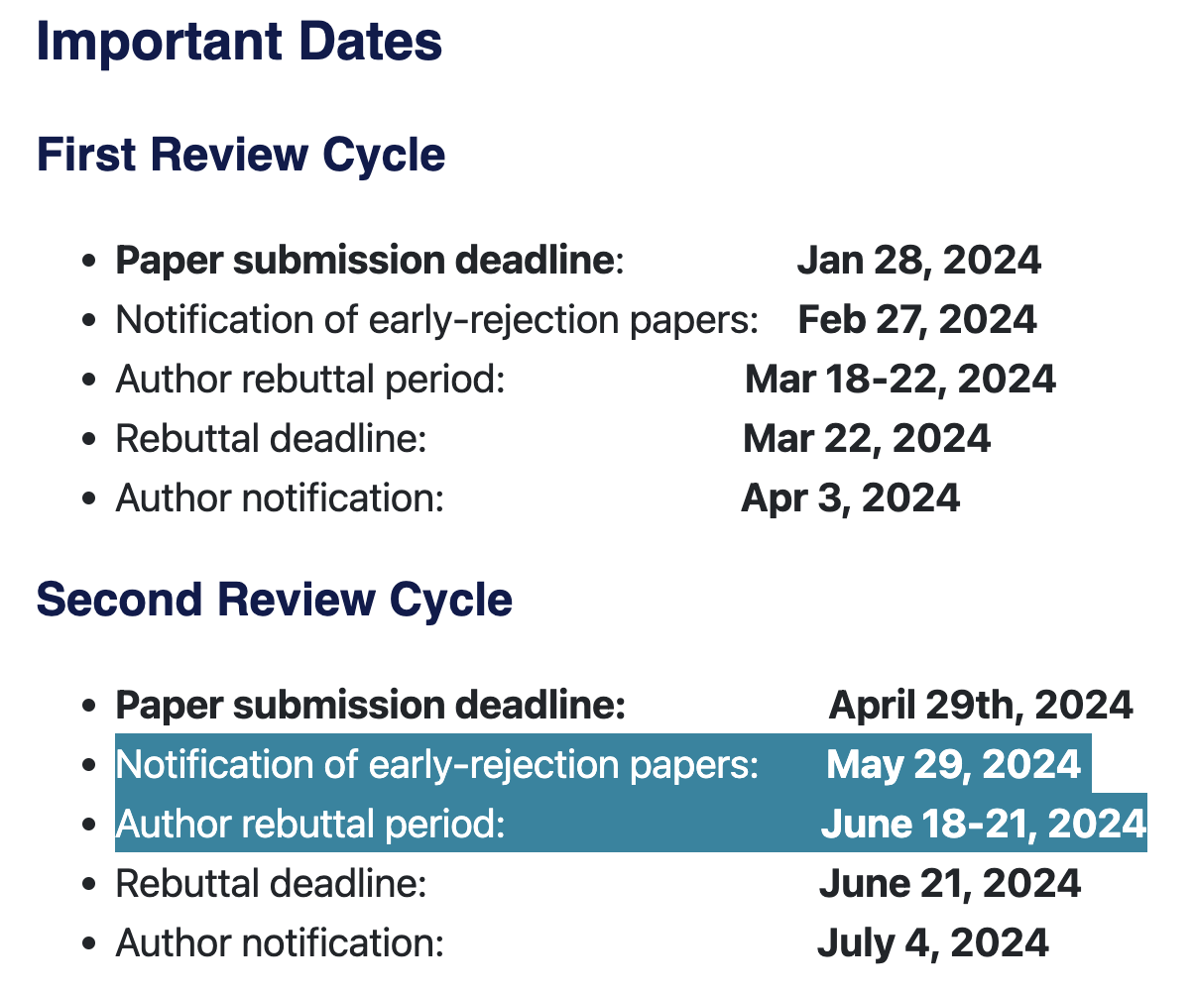
ACM CCS Important Dates

Slide 4
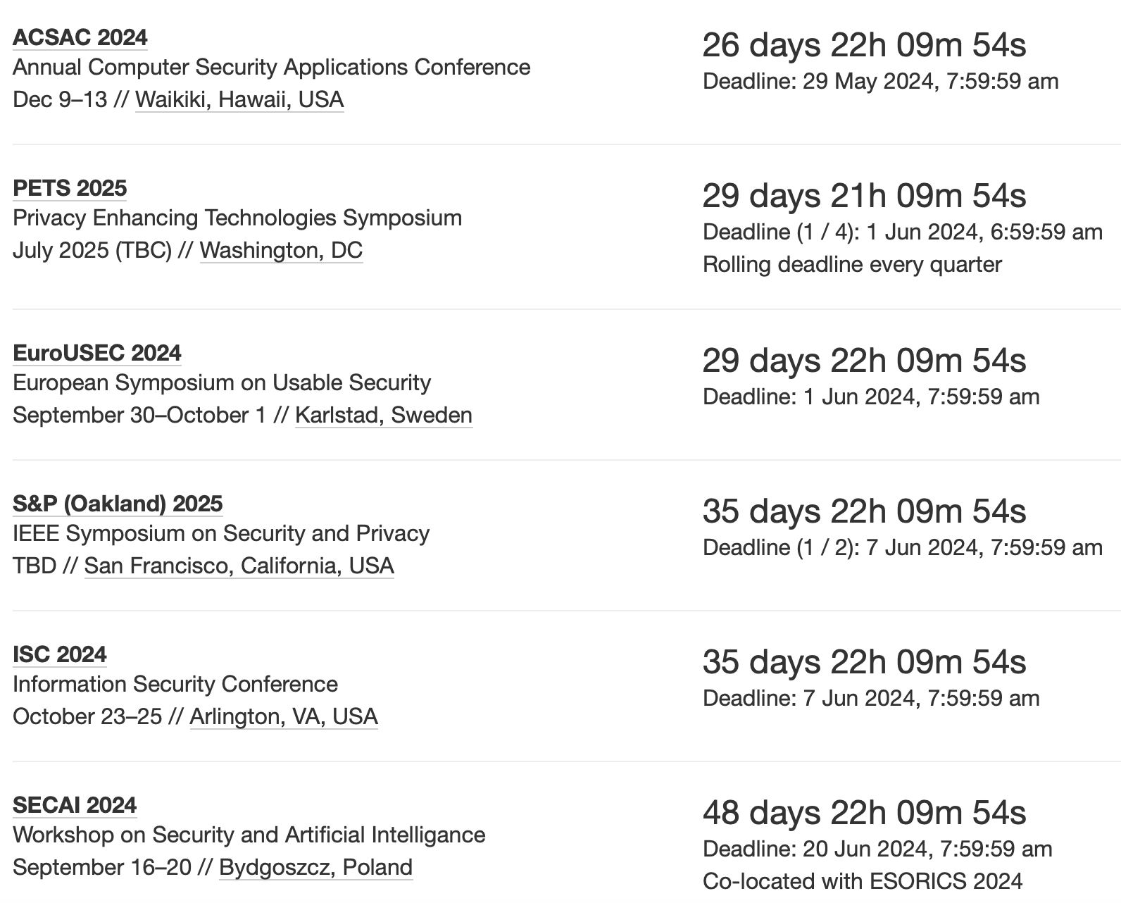

Incoming Security Conference Deadline
https://sec-deadlines.github.io
https://www.acsac.org/
Robustness of Foundation Model Vision
Bommasani, Rishi, Drew A. Hudson, Ehsan Adeli, Russ Altman, Simran Arora, Sydney von Arx, Michael S. Bernstein et al. "On the opportunities and risks of foundation models." arXiv preprint arXiv:2108.07258 (2021).
Zhuang, Weiming, Chen Chen, and Lingjuan Lyu. "When foundation model meets federated learning: Motivations, challenges, and future directions." arXiv preprint arXiv:2306.15546 (2023).

Slide 5
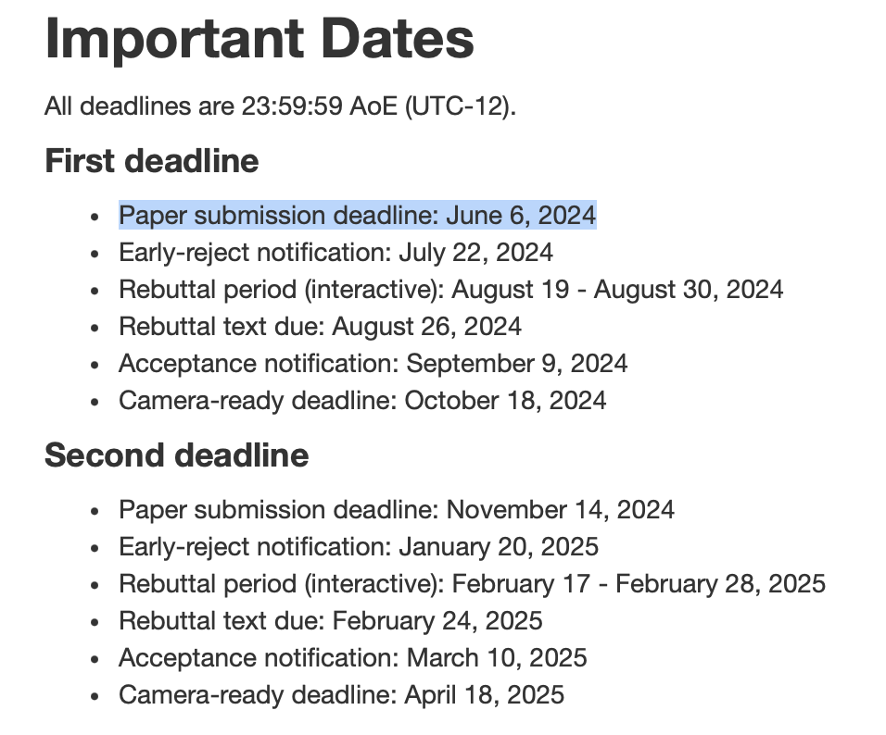
Incoming Security Conference Deadline
https://sec-deadlines.github.io
https://www.ieee-security.org/TC/SP2025/

Slide 6
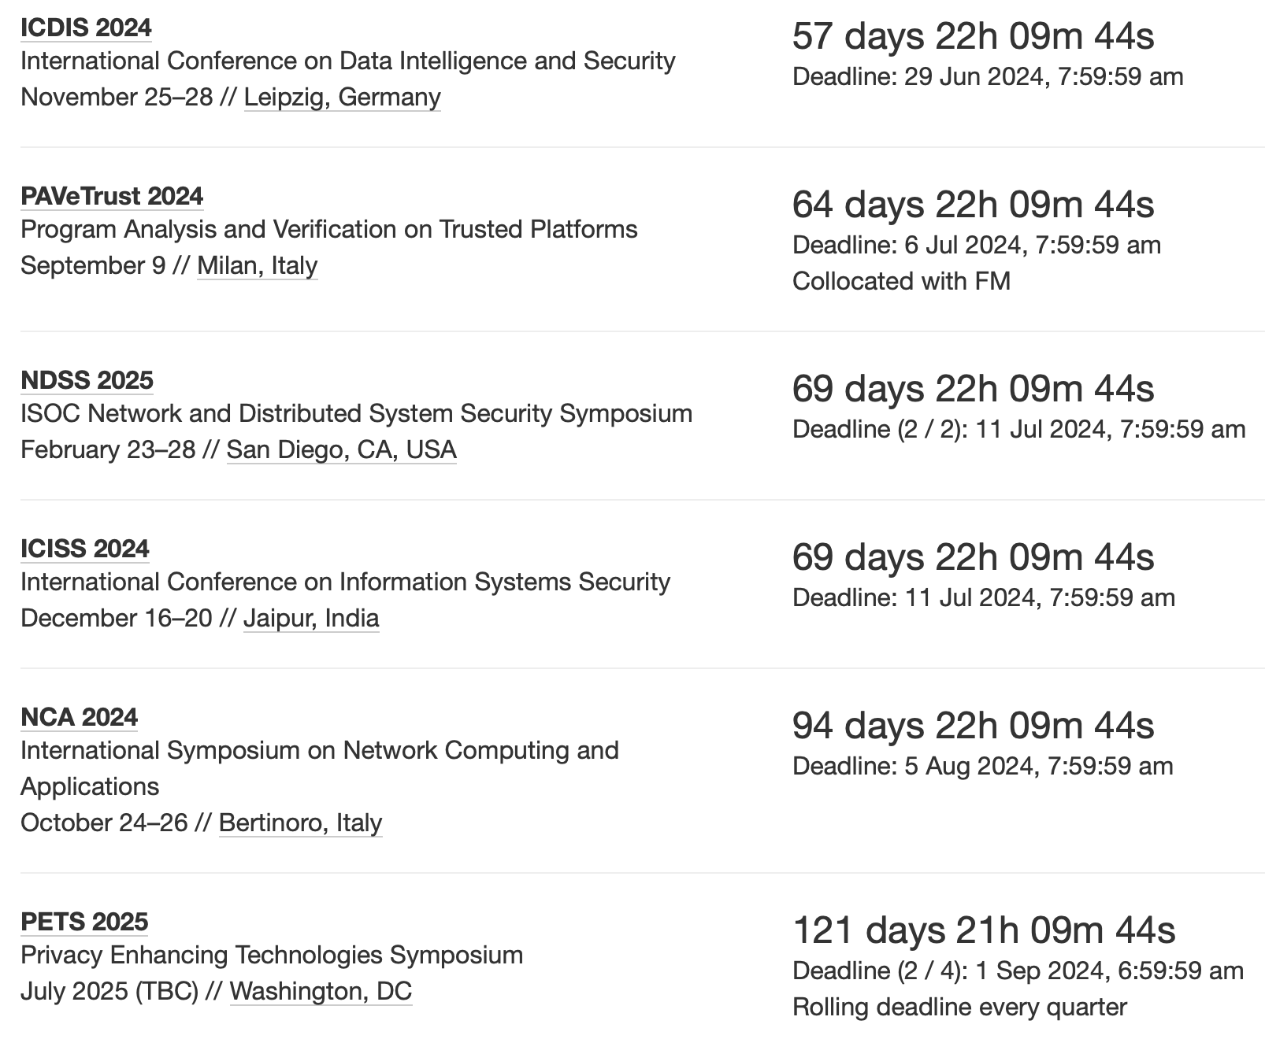
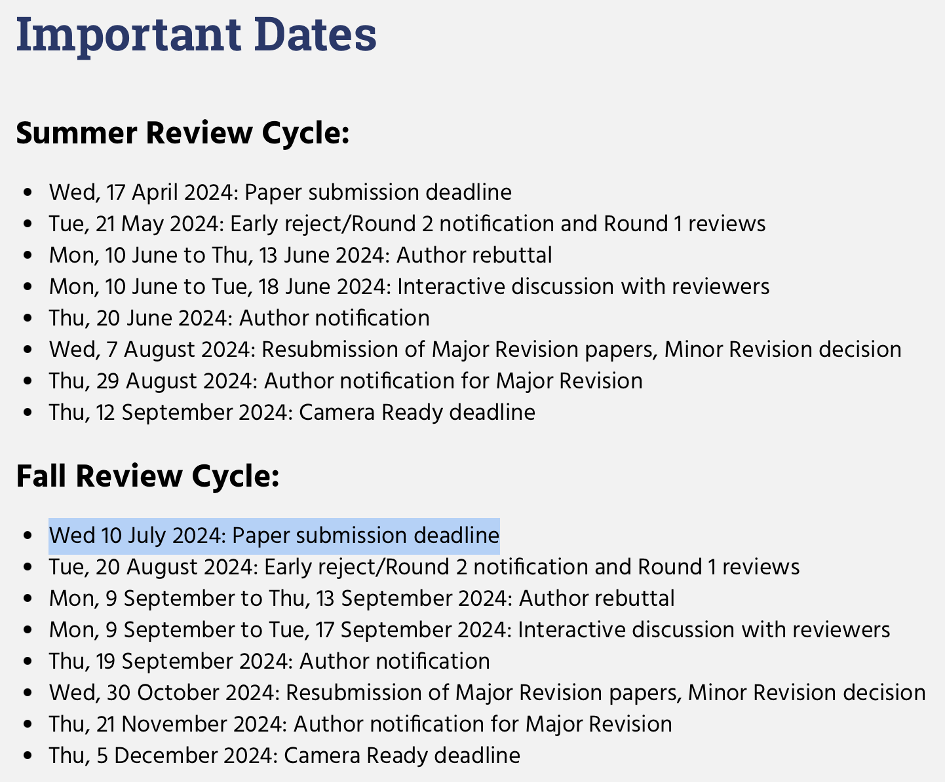
Incoming Security Conference Deadline
https://sec-deadlines.github.io
https://www.ndss-symposium.org/ndss2025/submisions/call-for-papers/

Slide 7
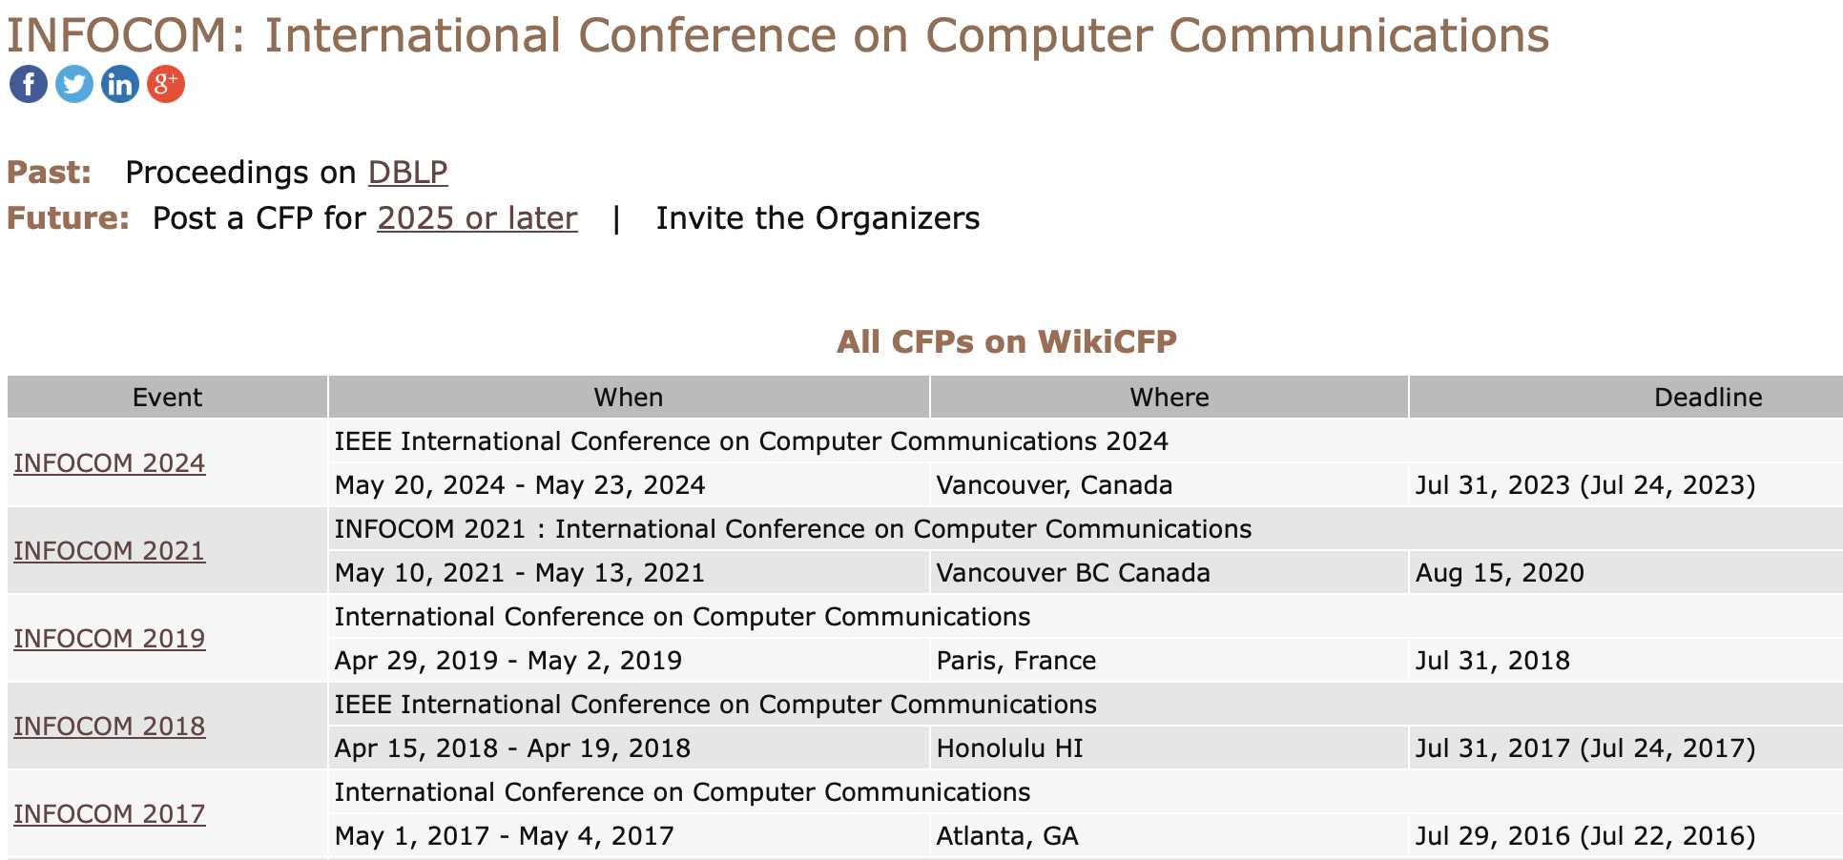
Incoming Network Conference Deadline
https://sec-deadlines.github.io
INFOCOM 2025:
IEEE INFOCOM
Full paper due: Maybe July 31, 2024
https://www.comsoc.org/conferences-events/ieee-international-conference-communications-2025

Slide 8

Incoming AI Conference Deadline
https://aideadlin.es/?sub=ML,CV,CG,NLP,RO,SP,DM,AP,KR,HCI
AAAI 2024:
The 38th Annual AAAI Conference on Artificial Intelligence
Full paper due: August 15, 2023
Others:
IEEE Transactions on Dependable and Secure Computing (TDSC)
IEEE Transactions on Information Forensics and Security (TIFS)
IEEE/ACM Transactions on Networking (TON)
https://aaai.org/aaai-conference/
submitting new paper finished in Summer.

Slide 9
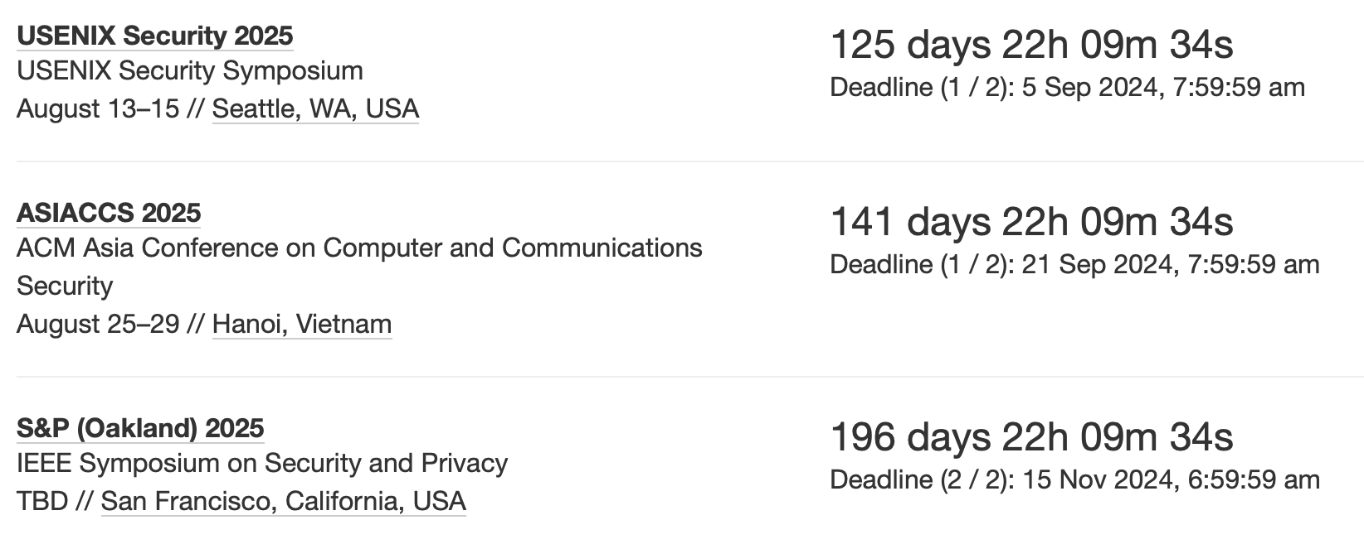
Incoming Security Conference Deadline
https://sec-deadlines.github.io
https://www.ndss-symposium.org/ndss2025/submisions/call-for-papers/
submitting new paper finished in Summer.

Slide 10
Estimated Time for Other Matters
Graduation Preparation
Blind Review PhD Thesis: 16 October.
Defense: Finished before 31 November.
Estimated time to receive degree: 31 December.
Visiting Program at Purdue
The expiration date of the current visiting program: October 10, 2024
Extended to January 10 (based on estimated time to degree)
Join Postdoc in 2025
Try to get an offer in August 10, then apply for remote graduation two months in advance.
Extending the rental contract in West Lafayette before 12 July.

Slide 11
May 2, 2024
Discuss Possible Future Work

Slide 12

Possible Future Research Directions (Discussed with Professor in Oct. 2023)
Distribution of the noised input detection technique towards adaptive adversary
Enhance the adaptability when selecting smoothing distribution for randomized smoothing
Technique to improve the certified robustness
The former studies quantitative evaluation of the robustness of a trained/deployed model,
The latter studies how to improve the certifiable robustness of the model through robust training.
Transfer the robustness of a well-robust trained model to a model without robust training
Transfer from a complex model to a simple model
Transfer from a domain-specific model to a new task/new domain model
Certify robustness of the LLM against adversarial prompt
Evaluating the certified robustness of LLM’s security filter
Enhance the certified robustness of LLM’s security filter
Sorted in no particular order

Slide 13
Possible Future Research Directions (Discuss with Professor Now)
Robust Learning of Training Data-Constrained Foundation Models
There has been some work focusing on training/fine-tuning LLMs with limited training inputs, but no attention has been paid to how to enhance robustness under this limitation.
GPT-4, GPT-3.5, Llama.
Certify the robustness of the LLM against adversarial prompt (human-crafted adversarial texts)
Evaluating the certified robustness of LLM’s security filter
Enhance the certified robustness of LLM’s security filter
Attack and Robustness of In-Context Learning
Attack: Since the prediction of in-context learning depends on the demonstrations, the chain dependency of the model on the context can be used to propagate or even diffuse error, thereby achieving the purpose of the attack.
Attack LLM Models
poisoning attack, backdoor attack, prompt injection, and extraction attack

Slide 14
Research Meeting
Maggie Huang
Prof. Elisa Bertino
May 21, 2024

Slide 15
Outline
Problems
Meta-Learning for Robustness
Definition of meta-learning
Optimization approaches for meta-training
Data-constraint LLM Learning
Designed for pre-training or fine-tuning
Transferability-based Adversarial Attack
Attack technique against surrogate model
Attacks and Defenses of LLM
Attacks on LLM
Robustness as meta-objective
Dataset size used for training
No training time cost analysis provided
LLM? Model size
Robustness of black-box model
Robustness of surrogate model
Defense of LLM

Slide 16
May 21, 2023
Meta-Learning for Robustness
Background and Related Work

Slide 17

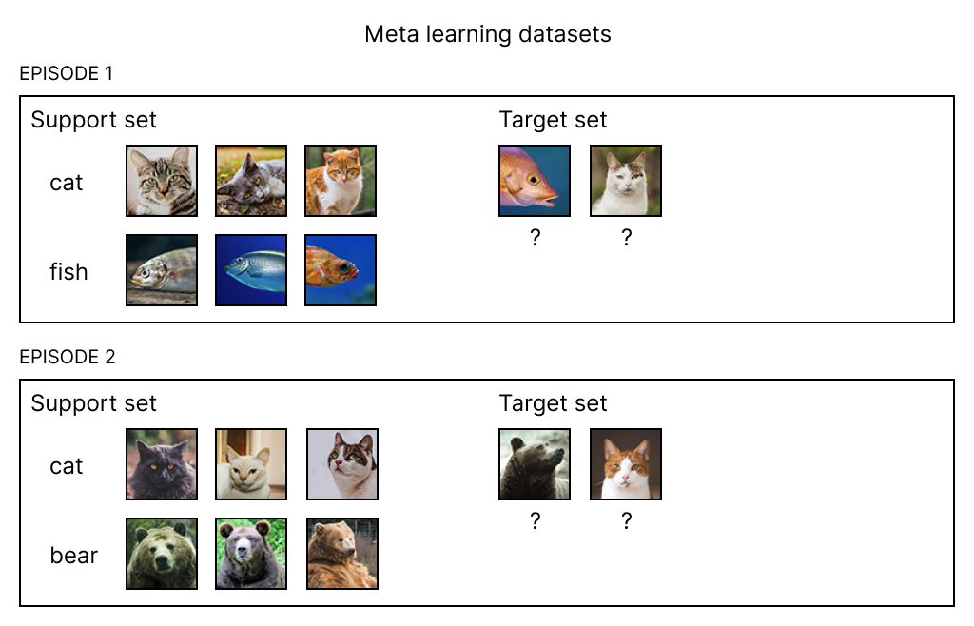
Meta-Learning Episode /ˈepəˌsōd/
A typical meta-learning episode involves the following steps:
Task Sampling: Randomly select a task from the task distribution.
Data Splitting: Divide the task's dataset into a support (train) set and a query (validation) set.
Model Training: Train the model using the support set.
Model Evaluation: Evaluate the model's performance on the query set. The performance metrics are then used to update the meta-learning model to improve its ability to adapt to new tasks.

Slide 18
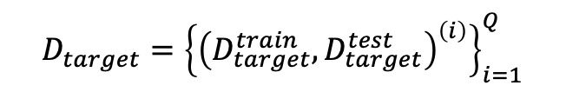
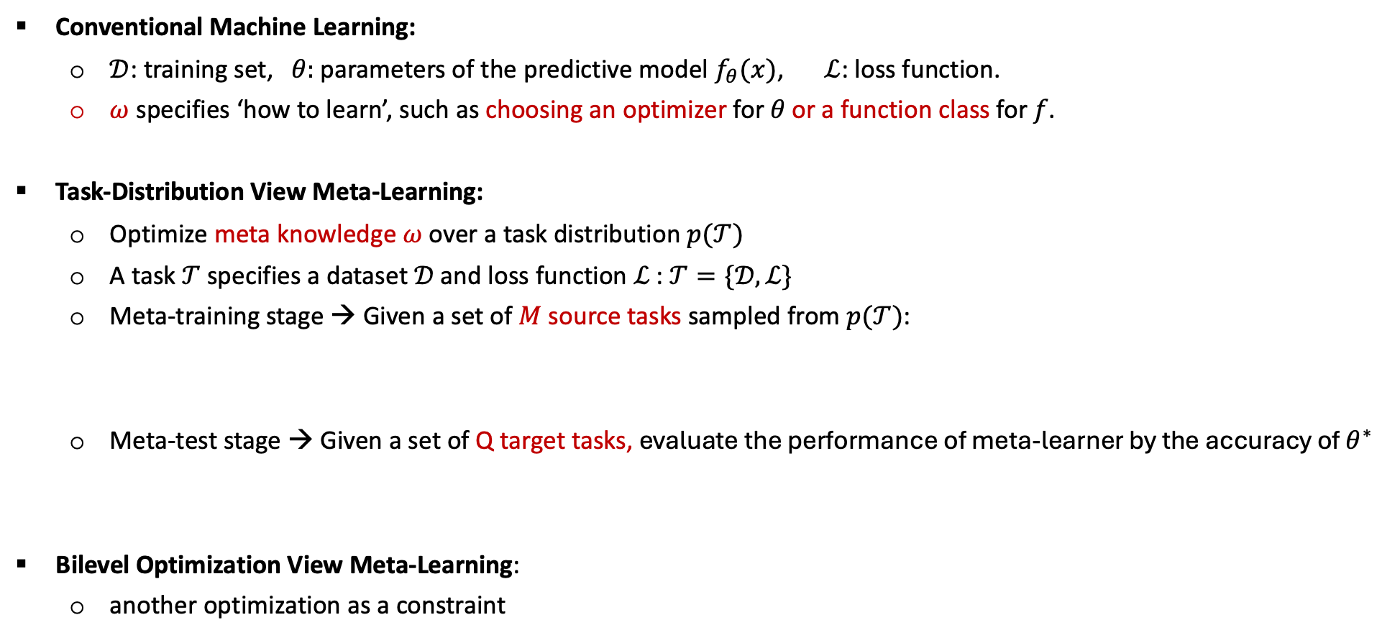
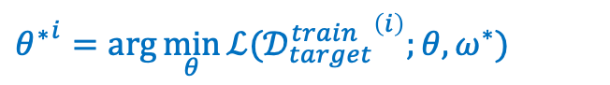
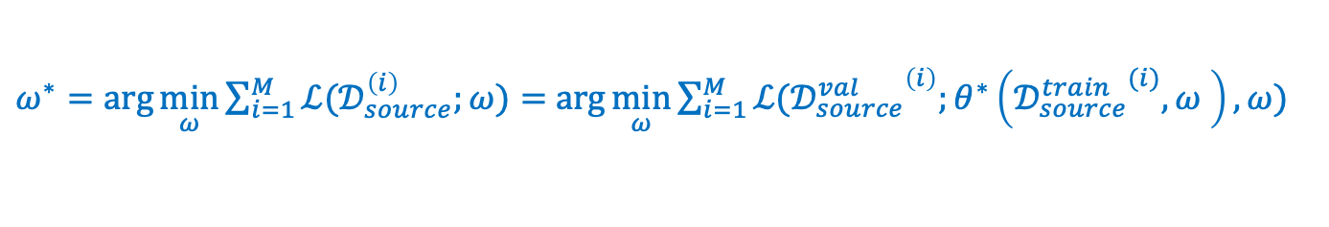
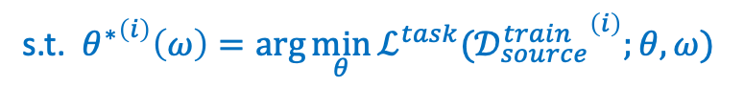
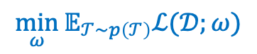
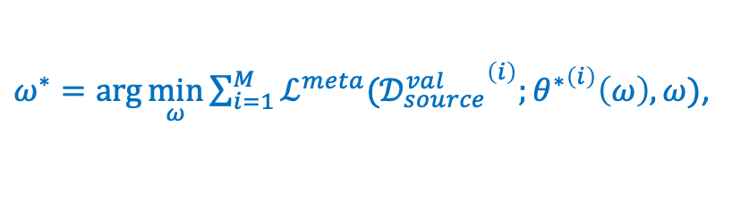
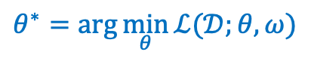
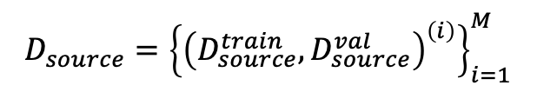
Formalization of Meta-learning (‘Learn to Learn’)
$$θ^{∗}=\arg{\min_{θ}{ℒ(𝒟;θ,ω)}}$$
Conventional Machine Learning:
$𝒟$: training set, $θ:$ parameters of the predictive model $f_{θ}(x)$, $ℒ$: loss function.
$ω$ specifies ‘how to learn’, such as choosing an optimizer for 𝜃 or a function class for 𝑓.
Task-Distribution View Meta-Learning:
Optimize meta knowledge $ω$ over a task distribution $p(𝒯)$
A task $𝒯$specifies a dataset $𝒟$and loss function $ℒ$: $𝒯=\{𝒟,ℒ\}$
Meta-training stage → Given a set of $M$source tasks sampled from $p(𝒯)$:
Meta-test stage → Given a set of Q target tasks, evaluate the performance of meta-learner by the accuracy of $θ^{∗}$
Bilevel Optimization View Meta-Learning:
another optimization as a constraint
$$\min_{ω}{𝔼_{𝒯\sim p\left(𝒯\right)}ℒ(𝒟;ω)}$$
Support set
$$D_{source}={\left\{{\left(D_{source}^{train},D_{source}^{val}\right)}^{\left(i\right)}\right\}}_{i=1}^{M}$$
$ω^{∗}=\arg{\min_{ω}{\sum_{i=1}^{M}{ℒ(𝒟_{source}^{\left(i\right)};ω)}}}=$ $\arg{\min_{ω}{\sum_{i=1}^{M}{ℒ({𝒟_{source}^{val}}^{\left(i\right)};θ^{∗}\left({𝒟_{source}^{train}}^{(i)},ω \right),ω)}}}$
Query set
$${θ^{∗}}^{i}=\arg{\min_{θ}{ℒ({𝒟_{target}^{train}}^{\left(i\right)};θ,ω^{∗})}}$$
$$D_{target}={\left\{{\left(D_{target}^{train},D_{target}^{test}\right)}^{\left(i\right)}\right\}}_{i=1}^{Q}$$
$ω^{∗}=\arg{\min_{ω}{\sum_{i=1}^{M}{ℒ^{meta}({𝒟_{source}^{val}}^{\left(i\right)};{θ^{∗}}^{\left(i\right)}\left(ω\right),ω)}}}$,
s.t. ${θ^{∗}}^{\left(i\right)}\left(ω\right)=\arg{\min_{θ}{ℒ^{task}({𝒟_{source}^{train}}^{\left(i\right)};θ,ω)}}$
"Meta-learning in neural networks: A survey." IEEE transactions on analysis and machine intelligence (TPAMI), 2021. pattern
Notes:
A semicolon ; is used to distinguish the main input variable $𝒟$ from model parameters $θ$ or other types of parameters $ω$.

Slide 19
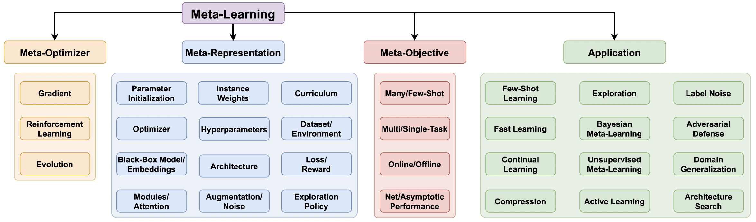
Meta-Knowledge $ω$ to Meta-learn
What content can be used as learning objects for meta-learning (meta-knowledge) ?
"Meta-learning in neural networks: A survey." IEEE transactions on analysis and machine intelligence (TPAMI), 2021. pattern

Slide 20


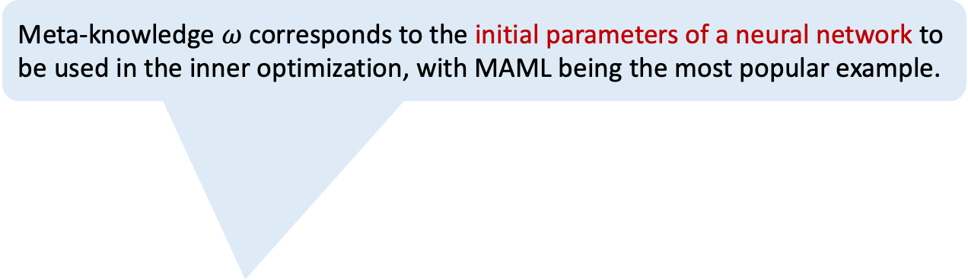
Meta-Knowledge $ω$ to Meta-learn
Meta-knowledge $ω$ corresponds to the initial parameters of a neural network to be used in the inner optimization, with MAML being the most popular example.
The parameter-centric methods usually rely on existing optimizers such as SGD or Adam to refine the initialization when given some new task.
What content can be used as learning objects for meta-learning (meta-knowledge) ?
$ω^{∗}=\arg{\min_{ω}{\sum_{i=1}^{M}{ℒ^{meta}({𝒟_{source}^{val}}^{\left(i\right)};{θ^{∗}}^{\left(i\right)}\left(ω\right),ω)}}}$,
s.t. ${θ^{∗}}^{\left(i\right)}\left(ω\right)=\arg{\min_{θ}{ℒ^{task}({𝒟_{source}^{train}}^{\left(i\right)};θ,ω)}}$
"Model-agnostic meta-learning (MAML) for fast adaptation of deep networks." In ICML, 2017.

Slide 21
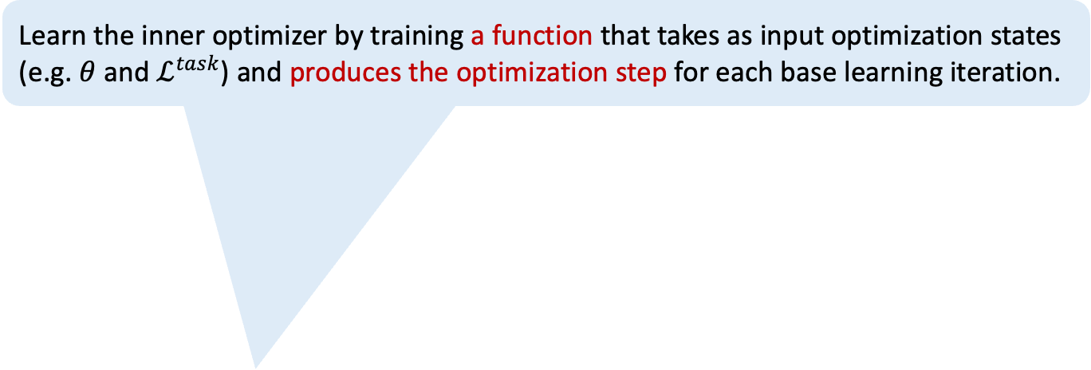
Meta-Knowledge $ω$ to Meta-learn
Learn the inner optimizer by training a function that takes as input optimization states (e.g. $θ$ and $ℒ^{task}$) and produces the optimization step for each base learning iteration.
What content can be used as learning objects for meta-learning (meta-knowledge) ?
$ω^{∗}=\arg{\min_{ω}{\sum_{i=1}^{M}{ℒ^{meta}({𝒟_{source}^{val}}^{\left(i\right)};{θ^{∗}}^{\left(i\right)}\left(ω\right),ω)}}}$,
s.t. ${θ^{∗}}^{\left(i\right)}\left(ω\right)=\arg{\min_{θ}{ℒ^{task}({𝒟_{source}^{train}}^{\left(i\right)};θ,ω)}}$

Slide 22
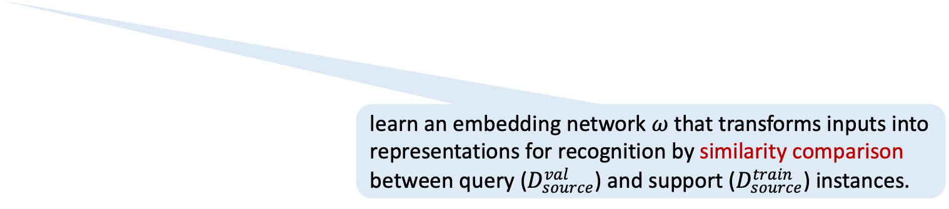
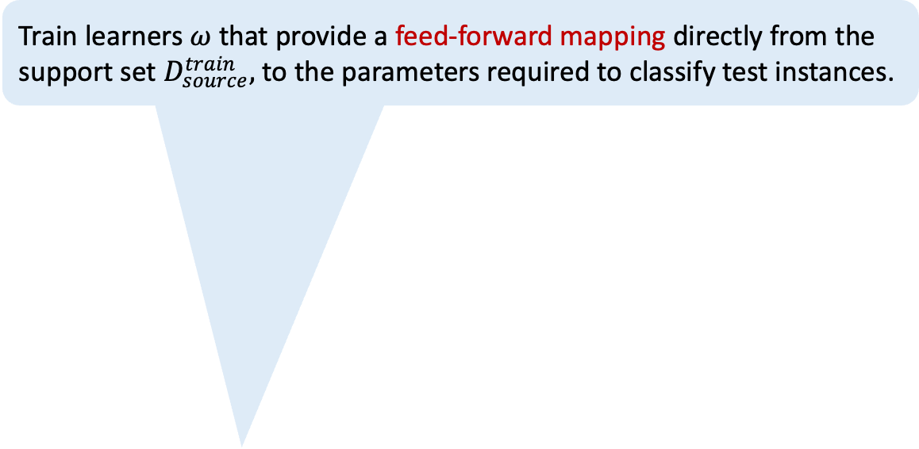
Meta-Knowledge $ω$ to Meta-learn
Train learners $ω$ that provide a feed-forward mapping directly from the support set $D_{source}^{train},$ to the parameters required to classify test instances.
What content can be used as learning objects for meta-learning (meta-knowledge) ?
learn an embedding network $ω$ that transforms inputs into representations for recognition by similarity comparison between query ($D_{source}^{val}$) and support ($D_{source}^{train}$) instances.

Slide 23
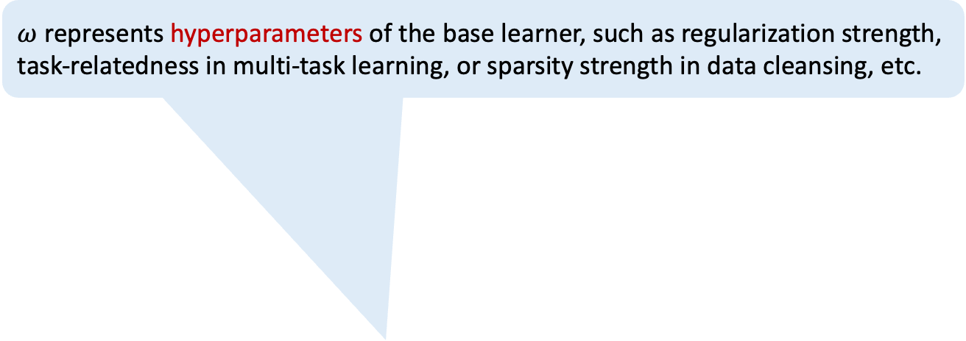
Meta-Knowledge $ω$ to Meta-learn
$ω$ represents hyperparameters of the base learner, such as regularization strength, task-relatedness in multi-task learning, or sparsity strength in data cleansing, etc.
What content can be used as learning objects for meta-learning (meta-knowledge) ?

Slide 24
Meta-Knowledge $ω$ to Meta-learn
Use evolutionary algorithms to learn the topology of LSTM cells or leverage RL to generate descriptions for good CNN architectures.
What content can be used as learning objects for meta-learning (meta-knowledge) ?

Slide 25
Meta-Knowledge $ω$ to Meta-learn
Learn the data augmentation strategy. Since augmentation operations are often non-differentiable, this requires reinforcement learning, discrete gradient estimators, or evolutionary methods.
What content can be used as learning objects for meta-learning (meta-knowledge) ?

Slide 26
Meta-Knowledge $ω$ to Meta-learn
When the base algorithm is minibatch-based stochastic gradient descent, a design parameter of the meta-learning strategy is the batch selection process.
When the base algorithm is minibatch-based stochastic gradient descent, a design parameter of the meta-learning strategy is the batch selection process.
What content can be used as learning objects for meta-learning (meta-knowledge) ?

Slide 27
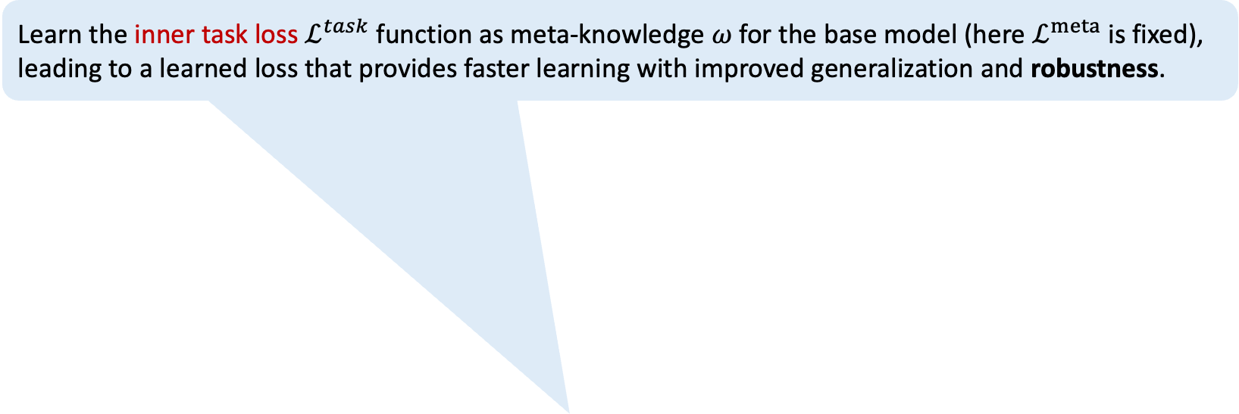
Meta-Knowledge $ω$ to Meta-learn
Learn the inner task loss $ℒ^{task}$ function as meta-knowledge $ω$ for the base model (here $ℒ^{meta}$ is fixed), leading to a learned loss that provides faster learning with improved generalization and robustness.
What content can be used as learning objects for meta-learning (meta-knowledge) ?
$ω^{∗}=\arg{\min_{ω}{\sum_{i=1}^{M}{ℒ^{meta}({𝒟_{source}^{val}}^{\left(i\right)};{θ^{∗}}^{\left(i\right)}\left(ω\right),ω)}}}$,
s.t. ${θ^{∗}}^{\left(i\right)}\left(ω\right)=\arg{\min_{θ}{ℒ^{task}({𝒟_{source}^{train}}^{\left(i\right)};θ,ω)}}$
"Searching for robustness: Loss learning for noisy classification tasks." In ICCV, 2021.

Slide 28
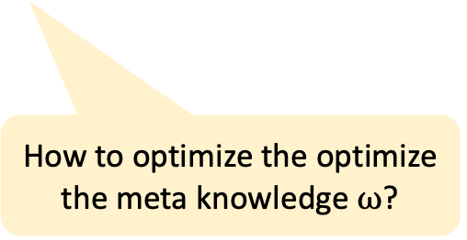
Optimization Approaches for Meta-Training
How to optimize the optimize the meta knowledge $ω$?

Slide 29

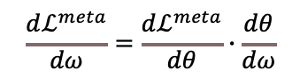
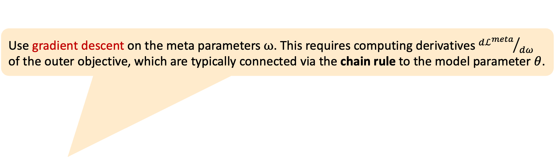
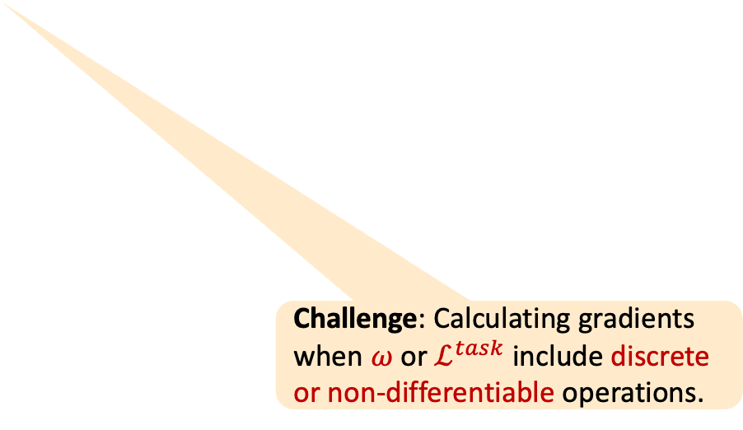
Optimization Approaches for Meta-Training
Use gradient descent on the meta parameters $ω$. This requires computing derivatives ${dℒ^{meta}}/{dω}$ of the outer objective, which are typically connected via the chain rule to the model parameter $θ$.
$$\frac{dℒ^{meta}}{dω}=\frac{dℒ^{meta}}{dθ}∙\frac{dθ}{dω}$$
How to optimize the optimize the meta knowledge $ω$?
Challenge: Calculating gradients when $ω$ or $ℒ^{task}$ include discrete or non-differentiable operations.
$ω^{∗}=\arg{\min_{ω}{\sum_{i=1}^{M}{ℒ^{meta}({𝒟_{source}^{val}}^{\left(i\right)};{θ^{∗}}^{\left(i\right)}\left(ω\right),ω)}}}$,
s.t. ${θ^{∗}}^{\left(i\right)}\left(ω\right)=\arg{\min_{θ}{ℒ^{task}({𝒟_{source}^{train}}^{\left(i\right)};θ,ω)}}$

Slide 30
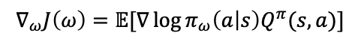
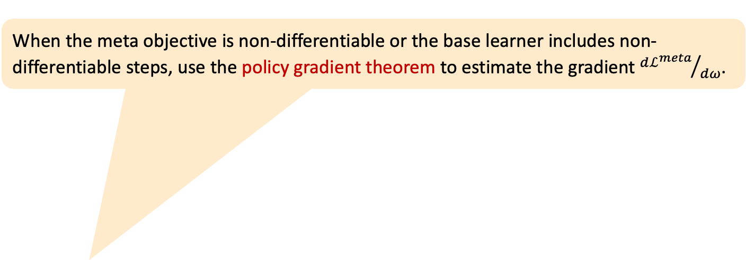
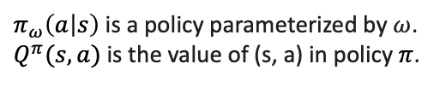
Optimization Approaches for Meta-Training
When the meta objective is non-differentiable or the base learner includes non-differentiable steps, use the policy gradient theorem to estimate the gradient ${dℒ^{meta}}/{dω}$.
$$∇_{ω}J\left(ω\right)=𝔼[∇\log{π_{ω}\left(a | s\right)Q^{π}(s,a)}]$$
$π_{ω}\left(a | s\right)$is a policy parameterized by $ω$.
$Q^{π}(s,a)$ is the value of (s, a) in policy $π$.
How to optimize the optimize the meta knowledge $ω$?
Challenge: extremely costly, high variance, converge requires many outer-level optimization steps.
$ω^{∗}=\arg{\min_{ω}{\sum_{i=1}^{M}{ℒ^{meta}({𝒟_{source}^{val}}^{\left(i\right)};{θ^{∗}}^{\left(i\right)}\left(ω\right),ω)}}}$,
s.t. ${θ^{∗}}^{\left(i\right)}\left(ω\right)=\arg{\min_{θ}{ℒ^{task}({𝒟_{source}^{train}}^{\left(i\right)};θ,ω)}}$
"Policy gradient methods for reinforcement learning with function approximation." NeurIPS,1999.

Slide 31
Optimization Approaches for Meta-Training
Use evolutionary algorithms (EA) to optimize the meta-objective. (i) no differentiability constraint. (ii) does not rely on backpropagation, thus avoiding gradient degradation issues and the cost of high-order gradient computation. (iii) highly parallelizable for scalability.
How to optimize the optimize the meta knowledge $ω$?
Challenge: The population size increases rapidly with the number of parameters to learn.
$ω^{∗}=\arg{\min_{ω}{\sum_{i=1}^{M}{ℒ^{meta}({𝒟_{source}^{val}}^{\left(i\right)};{θ^{∗}}^{\left(i\right)}\left(ω\right),ω)}}}$,
s.t. ${θ^{∗}}^{\left(i\right)}\left(ω\right)=\arg{\min_{θ}{ℒ^{task}({𝒟_{source}^{train}}^{\left(i\right)};θ,ω)}}$

Slide 32
Optimization Approaches for Meta-Training
Summary
Meta-learning more often uses RL and Evolution, as $ℒ^{meta}$ is often non-differentiable w.r.t. meta parameters $ω$.
How to optimize the optimize the meta knowledge $ω$?
$ω^{∗}=\arg{\min_{ω}{\sum_{i=1}^{M}{ℒ^{meta}({𝒟_{source}^{val}}^{\left(i\right)};{θ^{∗}}^{\left(i\right)}\left(ω\right),ω)}}}$,
s.t. ${θ^{∗}}^{\left(i\right)}\left(ω\right)=\arg{\min_{θ}{ℒ^{task}({𝒟_{source}^{train}}^{\left(i\right)};θ,ω)}}$

Slide 33
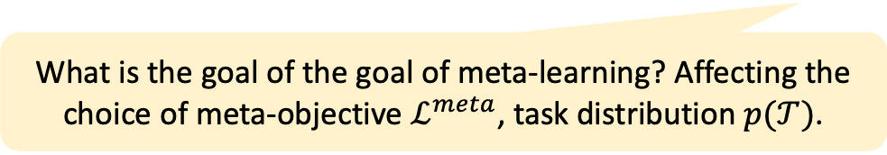
Goals of Meta-Learning
What is the goal of the goal of meta-learning? Affecting the choice of meta-objective $ℒ^{meta}$, task distribution $p(𝒯)$.

Slide 34
Goals of Meta-Learning
Many-Shot Learning: inner loop learning episodes are defined with many examples per task.
Few-Shot Learning: inner loop learning episodes are defined with few examples per task.
What is the goal of the goal of meta-learning? Affecting the choice of meta-objective $ℒ^{meta}$, task distribution $p(𝒯)$.
$ω^{∗}=\arg{\min_{ω}{\sum_{i=1}^{M}{ℒ^{meta}({𝒟_{source}^{val}}^{\left(i\right)};{θ^{∗}}^{\left(i\right)}\left(ω\right),ω)}}}$,
s.t. ${θ^{∗}}^{\left(i\right)}\left(ω\right)=\arg{\min_{θ}{ℒ^{task}({𝒟_{source}^{train}}^{\left(i\right)};θ,ω)}}$

Slide 35
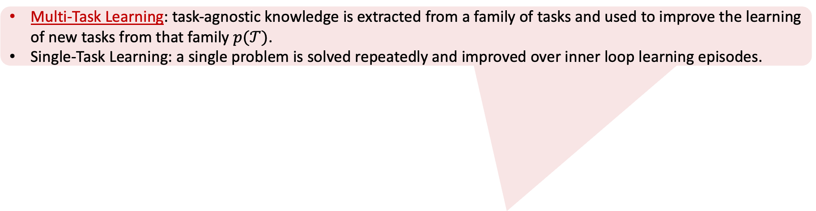
Goals of Meta-Learning
Multi-Task Learning: task-agnostic knowledge is extracted from a family of tasks and used to improve the learning of new tasks from that family $p(𝒯)$.
Single-Task Learning: a single problem is solved repeatedly and improved over inner loop learning episodes.
What is the goal of the goal of meta-learning? Affecting the choice of meta-objective $ℒ^{meta}$, task distribution $p(𝒯)$.
$ω^{∗}=\arg{\min_{ω}{\sum_{i=1}^{M}{ℒ^{meta}({𝒟_{source}^{val}}^{\left(i\right)};{θ^{∗}}^{\left(i\right)}\left(ω\right),ω)}}}$,
s.t. ${θ^{∗}}^{\left(i\right)}\left(ω\right)=\arg{\min_{θ}{ℒ^{task}({𝒟_{source}^{train}}^{\left(i\right)};θ,ω)}}$

Slide 36
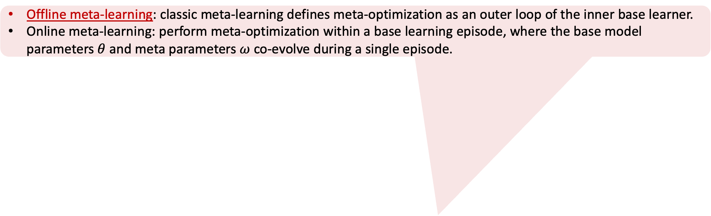
Goals of Meta-Learning
Offline meta-learning: classic meta-learning defines meta-optimization as an outer loop of the inner base learner.
Online meta-learning: perform meta-optimization within a base learning episode, where the base model parameters $θ$ and meta parameters $ω$ co-evolve during a single episode.
What is the goal of the goal of meta-learning? Affecting the choice of meta-objective $ℒ^{meta}$, task distribution $p(𝒯)$.
$ω^{∗}=\arg{\min_{ω}{\sum_{i=1}^{M}{ℒ^{meta}({𝒟_{source}^{val}}^{\left(i\right)};{θ^{∗}}^{\left(i\right)}\left(ω\right),ω)}}}$,
s.t. ${θ^{∗}}^{\left(i\right)}\left(ω\right)=\arg{\min_{θ}{ℒ^{task}({𝒟_{source}^{train}}^{\left(i\right)};θ,ω)}}$

Slide 37
Goals of Meta-Learning
Encourage final performance: compute validation loss at the end of the inner learning episode
Encourage fast performance: compute validation loss as the sum of the validation loss after each inner optimization step
What is the goal of the goal of meta-learning? Affecting the choice of meta-objective $ℒ^{meta}$, task distribution $p(𝒯)$.
$ω^{∗}=\arg{\min_{ω}{\sum_{i=1}^{M}{ℒ^{meta}({𝒟_{source}^{val}}^{\left(i\right)};{θ^{∗}}^{\left(i\right)}\left(ω\right),ω)}}}$,
s.t. ${θ^{∗}}^{\left(i\right)}\left(ω\right)=\arg{\min_{θ}{ℒ^{task}({𝒟_{source}^{train}}^{\left(i\right)};θ,ω)}}$

Slide 38
Application Areas of Meta-Learning
The ways in which meta-learning can be exploited

Slide 39
Application Areas of Meta-Learning
Domain generalization: learn different kinds of meta-knowledge, such as regularizers, losses, and noise augmentation, to maximize the robustness of the model to train-test domain shift. (such as photo/sketch/cartoon.)
The ways in which meta-learning can be exploited
"Feature-critic networks for heterogeneous domain generalization." In ICML, 2019. meta learn loss
"Metareg: Towards domain generalization using meta-regularization." NeurIPS, 2018. meta learn regularizer
"Cross-Domain Few-Shot Classification via Learned Feature-Wise Transformation." In ICLR. 2020. meta learn noise augmentation

Slide 40
Application Areas of Meta-Learning
Analogous to the case in domain-shift, train the learning algorithm for robustness by defining a meta-loss in terms of performance under adversarial attack.
The ways in which meta-learning can be exploited
"Adversarially robust few-shot learning: A meta-learning approach." NeurIPS, 2020. meta learn loss
"Adversarial meta-learning." arXiv preprint arXiv:1806.03316 (2018).

Slide 41
Application Areas of Meta-Learning
Summary
Few-shot Learning: quickly adapt to new tasks with minimal training data by leveraging knowledge from related tasks.
Reinforcement Learning: quickly adapt to new environments or tasks in scenarios where an agent needs to learn optimal policies efficiently in different but related settings.
Hyperparameter Optimization: reduce the computational cost and time involved in hyperparameter tuning by learning the best hyperparameter settings across different tasks.
Neural Architecture search: speed up the process of finding optimal neural network architectures by learning which architectures perform well across different tasks.

Slide 42
Related work that take robustness as a meta-learning object
Robustness to adversarial attack
"Adversarially robust few-shot learning: A meta-learning approach (Adversarial Query)." NeurIPS, 2020, define a meta-loss considering adversarial attacks.
"Adversarial meta-learning (ADML)." arXiv preprint arXiv:1806.03316 (2018).
Generalization (Robustness) to domain shift:
"Feature-critic networks for heterogeneous domain generalization." ICML, 2019, set loss as meta knowledge
"Metareg: Towards domain generalization using meta-regularization." NeurIPS, 2018, set regularizer as meta knowledge
"Cross-Domain Few-Shot Classification via Learned Feature-Wise Transformation." ICLR, 2020, set noise augmentation as meta knowledge
Robustness to label noise
"Learning to learn from noisy labeled data." CVPR, 2019.
"Meta-weight-net: Learning an explicit mapping for sample weighting." NeurIPS, 2019.

Slide 43
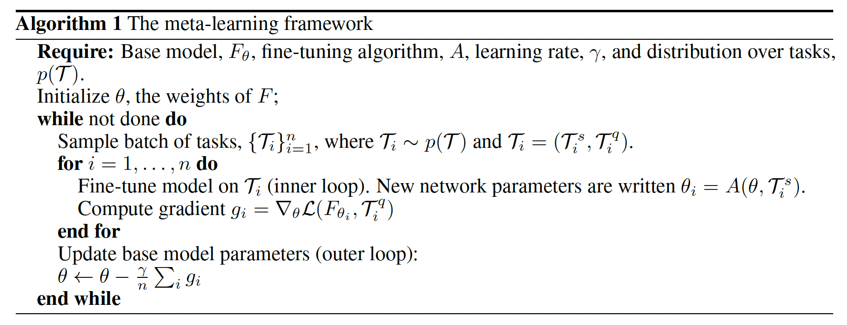
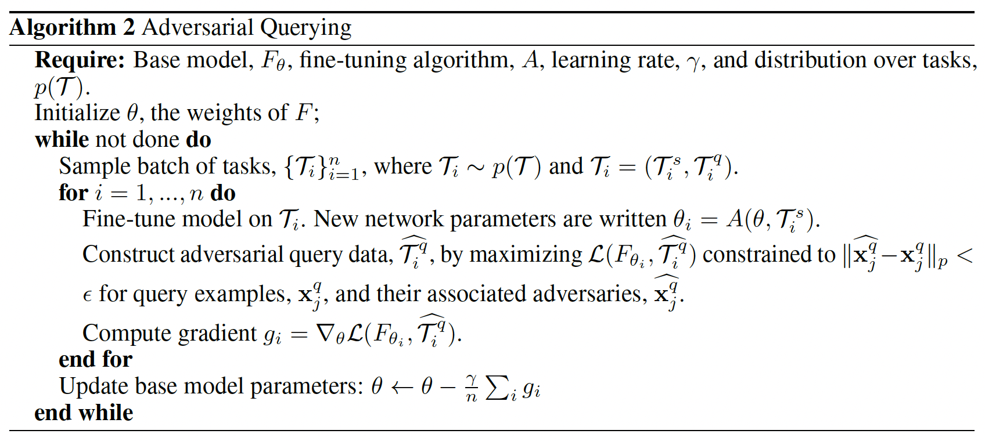
Paper 1: [NeurIPS20’] Adversarially Robust Few-Shot Learning: A Meta-learning Approach
Previous finding:
Previous work on adversarially robust neural networks for image classification requires large training sets and computationally expensive training procedures.
Few-shot learning methods are highly vulnerable to adversarial examples.
The problem this work solved:
Produce networks which both perform well at few-shot classification tasks and are robust to adversarial examples.
Core Idea:
Propose Adversarial Querying (AQ) for producing adversarially robust meta-learners.
Adversarial sample
Clean sample
Notes:
In the “inner loop” of training, the base model is fine-tuned on the support data from the sampled tasks.
In the “outer loop” of training, the fine-tuned network is used to make predictions on the query data, and the base model parameters are updated to improve the accuracy of the resulting fine-tuned model.

Slide 44
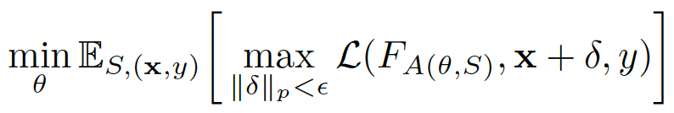
Paper 1: [NeurIPS20’] Adversarially Robust Few-Shot Learning: A Meta-learning Approach
Core Idea:
Expose the model to adversarial attacks during the query step of meta-learning.
This algorithm-agnostic method produces a robust feature extractor.
Meta-Objective:
Few (5)-shot image classification task
Dataset:
CIFAR-Few Shot (32X32): divides CIFAR-100 into 64 training, 16 validation, and 20 test classes.
Mini-ImageNet (84X84): 64 training, 16 validation, and 20 test classes.
Omniglot (105X105): 30 alphabets in background set, 20 alphabets evaluation set.
A typical meta-learning episode involves the following steps:
Task Sampling: Randomly select a task from the task distribution.
Data Splitting: Divide the task's dataset into a support (train) set and a query (validation) set.
Model Training: Train the model using the support set.
Model Evaluation:
Perturb query data to maximize query loss
Backpropagate to minimize query loss to update meta model
Meta-objective: find a central parameter vector which, when fine-tuned on support data, minimizes the expected query loss against an attacker.
Adversarial sample
44
Notes:
the meta objective is to find a central parameter vector which, when fine-tuned on support data, minimizes the expected query loss against an attacker

Slide 45
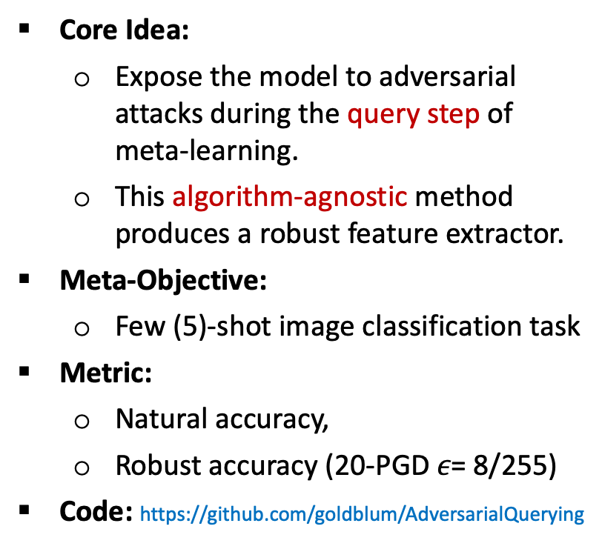
Paper 1: [NeurIPS20’] Adversarially Robust Few-Shot Learning: A Meta-learning Approach
Core Idea:
Expose the model to adversarial attacks during the query step of meta-learning.
This algorithm-agnostic method produces a robust feature extractor.
Meta-Objective:
Few (5)-shot image classification task
Metric:
Natural accuracy,
Robust accuracy (20-PGD $ε\text{= 8/255}$)
Code: https://github.com/goldblum/AdversarialQuerying
A typical meta-learning episode involves the following steps:
Task Sampling: Randomly select a task from the task distribution.
Data Splitting: Divide the task's dataset into a support (train) set and a query (validation) set.
Model Training: Train the model using the support set.
Model Evaluation:
Perturb query data to maximize query loss
Backpropagate to minimize query loss to update meta model
Meta-objective: find a central parameter vector which, when fine-tuned on support data, minimizes the expected query loss against an attacker.
Adversarial sample
45

Slide 46
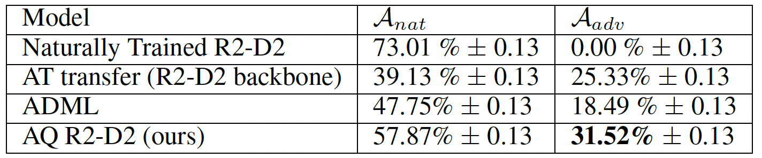
Paper 1: [NeurIPS20’] Adversarially Robust Few-Shot Learning: A Meta-learning Approach
Compared Methods:
Natural trained Meta-Learning
MAML: uses SGD to update all parameters, minimizing cross-entropy loss.
R2-D2: updates the final linear layer and replaces SGD with a closed-form differentiable solver.
MetaOptNet: updates the final linear layer and replaces SGD with a solver for SVM.
ProtoNet: metric learning aka embedding function-based meta-learning.
Transfer Learning from adversarially trained models
Adversarial Meta-Learning (ADML):
First attempt at meta-learning for robustness
Designed only for MAML
Computationally expensive
Finding:
Naturally trained meta-learning methods are not robust.
While clean-trained MAML models with adversarial fine-tuning are slightly more robust than naturally trained MAML, they achieve almost no robustness on Mini-ImageNet
Adversarial querying is more robust than robust transfer learning from adversarially trained models.
5-shot Mini-ImageNet
46

Slide 47
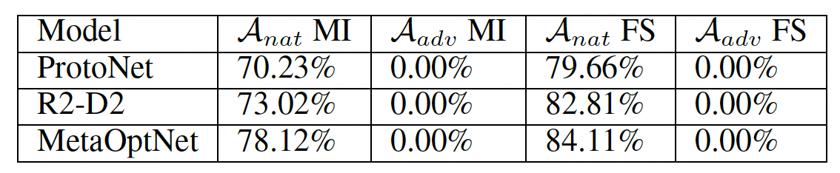
Paper 1: [NeurIPS20’] Adversarially Robust Few-Shot Learning: A Meta-learning Approach
Compared Methods:
Natural trained Meta-Learning
MAML: uses SGD to update all parameters, minimizing cross-entropy loss.
R2-D2: updates the final linear layer and replaces SGD with a closed-form differentiable solver.
MetaOptNet: updates the final linear layer and replaces SGD with a solver for SVM.
ProtoNet: metric learning aka embedding function-based meta-learning.
Transfer Learning from adversarially trained models
Adversarial Meta-Learning (ADML):
First attempt at meta-learning for robustness
Designed only for MAML
Computationally expensive
Finding:
Naturally trained meta-learning methods are not robust.
While clean-trained MAML models with adversarial fine-tuning are slightly more robust than naturally trained MAML, they achieve almost no robustness on Mini-ImageNet
Adversarial querying is more robust than robust transfer learning from adversarially trained models.
5-shot Mini-ImageNet (MI) and CIFAR-FS (FS)
47

Slide 48
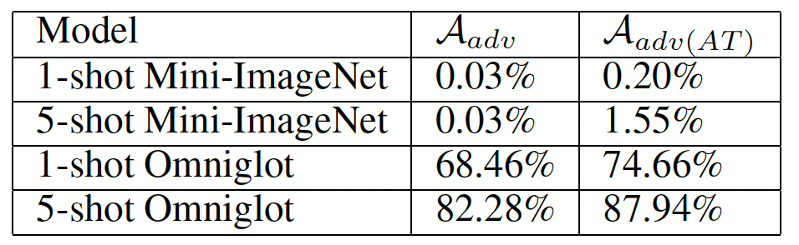
Paper 1: [NeurIPS20’] Adversarially Robust Few-Shot Learning: A Meta-learning Approach
Compared Methods:
Natural trained Meta-Learning
MAML: uses SGD to update all parameters, minimizing cross-entropy loss.
R2-D2: updates the final linear layer and replaces SGD with a closed-form differentiable solver.
MetaOptNet: updates the final linear layer and replaces SGD with a solver for SVM.
ProtoNet: metric learning aka embedding function-based meta-learning.
Transfer Learning from adversarially trained models
Adversarial Meta-Learning (ADML):
First attempt at meta-learning for robustness
Designed only for MAML
Computationally expensive
Finding:
Naturally trained meta-learning methods are not robust.
While clean-trained MAML models with adversarial fine-tuning are slightly more robust than naturally trained MAML, they achieve almost no robustness on Mini-ImageNet
Adversarial querying is more robust than robust transfer learning from adversarially trained models.
MAML on Mini-ImageNet (MI) and Omniglot.
48
Notes:
to compare robust transfer learning and meta-learning,
we train the backbone networks from meta-learning algorithms on all training data simultaneously in the fashion of standard adversarial training using 7-PGD (not meta-learning).
we then fine-tune using the head from a meta-learning algorithm on top of the transferred feature extractor (backbone).

Slide 49
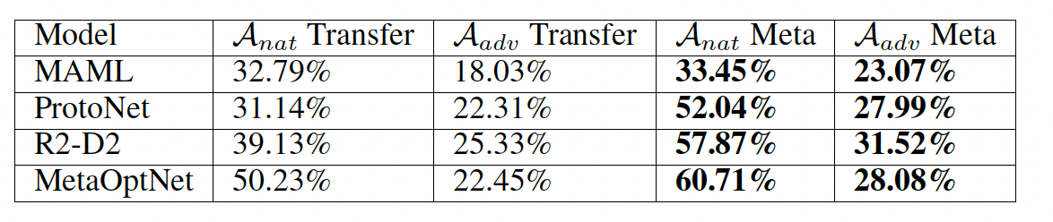
Paper 1: [NeurIPS20’] Adversarially Robust Few-Shot Learning: A Meta-learning Approach
Compared Methods:
Natural trained Meta-Learning
MAML: uses SGD to update all parameters, minimizing cross-entropy loss.
R2-D2: updates the final linear layer and replaces SGD with a closed-form differentiable solver.
MetaOptNet: updates the final linear layer and replaces SGD with a solver for SVM.
ProtoNet: metric learning aka embedding function-based meta-learning.
Transfer Learning from adversarially trained models
Adversarial Meta-Learning (ADML):
First attempt at meta-learning for robustness
Designed only for MAML
Computationally expensive
Finding:
Naturally trained meta-learning methods are not robust.
While clean-trained MAML models with adversarial fine-tuning are slightly more robust than naturally trained MAML, they achieve almost no robustness on Mini-ImageNet
AQ is more robust than transfer learning from adversarially trained models.
5-shot Mini-ImageNet
49
Notes:
Backbone means former representation layers
Head means last layer

Slide 50
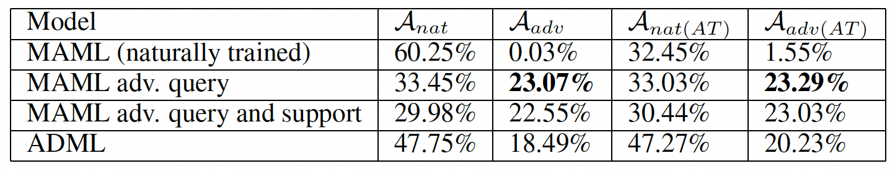
Paper 1: [NeurIPS20’] Adversarially Robust Few-Shot Learning: A Meta-learning Approach
Interpretation:
Why attack query data instead of support data?
Minimizing loss on adversarial query data moves the parameter vector toward a network with high robust test accuracy.
Attacking support data but not query data can be seen as maximizing clean test accuracy when fine-tuned in a robust manner, but since we want to maximize robust test accuracy, this would be inappropriate.
Should we attack both query and support data?
One reason to perturb only query data is computational efficiency.
If attacking support data during the inner loop of training enable improve d robust performance?
adversarially attacking the support data during the inner loop of meta-learning does not improve performance over adversarial querying
50
Notes:
Backbone means former representation layers
Head means last layer

Slide 51
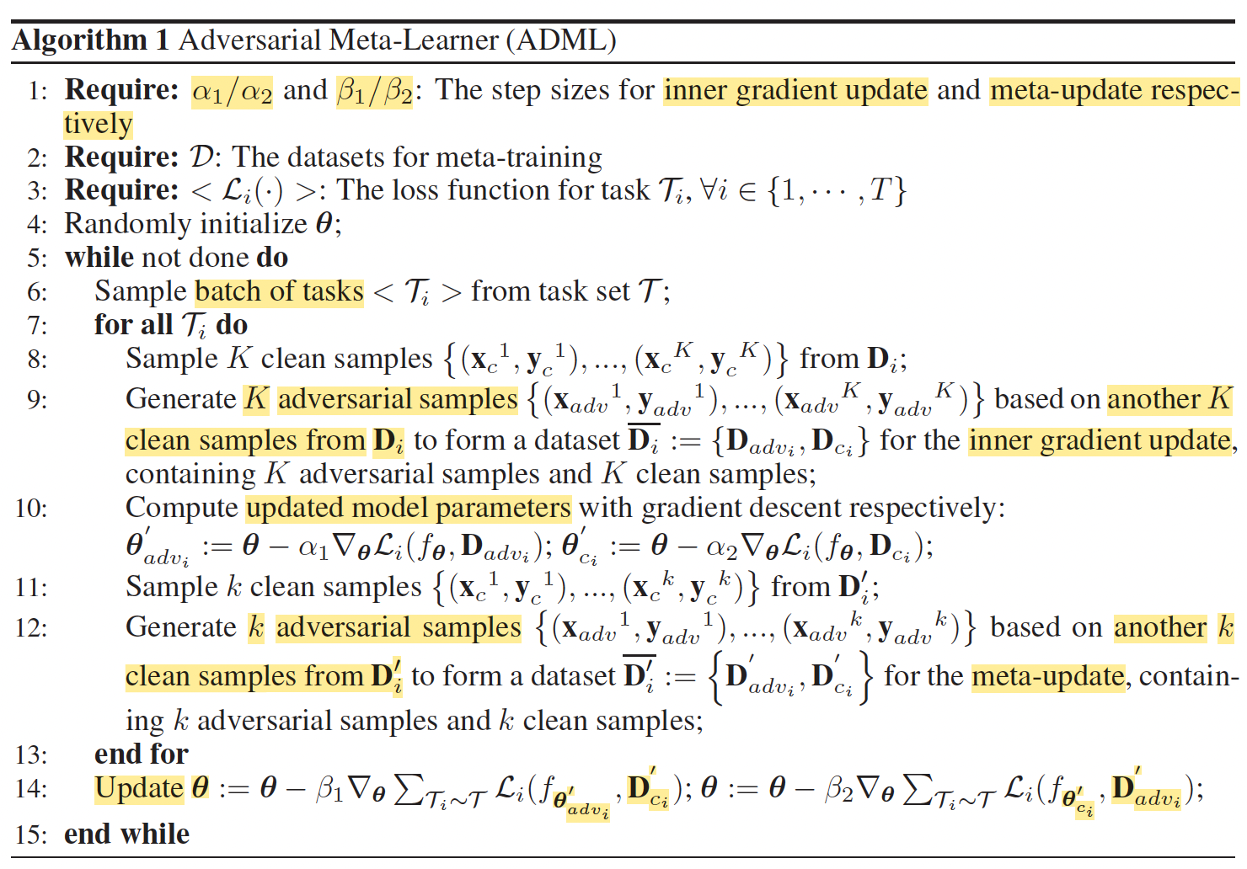
Paper 2: [ArXiv18’] Adversarial Meta-Learning (AQ has been compared with this)
The problem this work solved:
Study the meta-learning with FGSM adversarial samples.
Core Idea:
Propose ADML (ADversarialMeta-Learner), which leverages clean and adversarial samples to optimize the initialization of a learning model in an adversarial manner.
The key idea is to utilize correlations between clean and adversarial samples to let the inner gradient update and the meta-update arm-wrestle to obtain an initialization of model robust to adversarial samples.
Meta-Objective:
Few (5)-shot image classification task
adversarial training on support set
adversarial training on query set

Slide 52
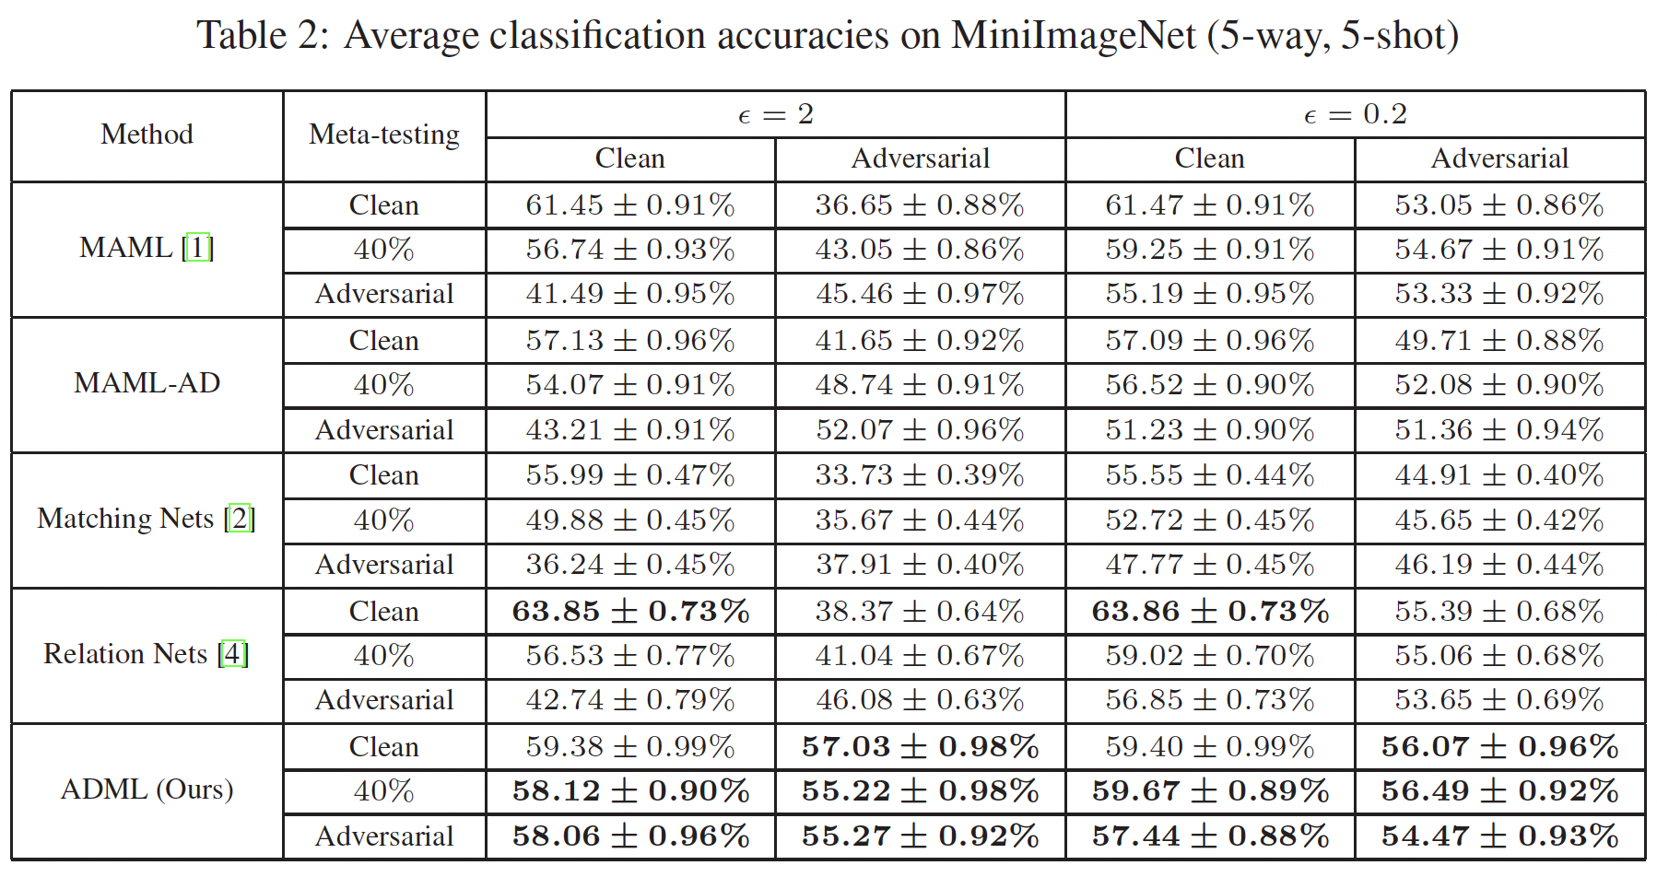
Paper 2: [ArXiv18’] Adversarial Meta-Learning (AQ has been compared with this)
Dataset:
Mini-ImageNet: a benchmark for few-shot learning, includes 100 classes, each class has 600 samples.
CIFAR-100: it has 100 classes, each of which contains 600 images.
Model
VGG16 network
Metric:
Natural (Clean) accuracy
Robust accuracy (FGSM)
Compared methods:
Natural meta learner
MAML
Matching Networks
Relation Networks
MAML-AD: mix adv and clean
Code: not open.
Each column represents the testing data (or query set) for evaluation
adversarial
adversarial
each row represents the training data used in the inner gradient update (or support set) during the meta-testing.

Slide 53

Outline
Problems
Meta-Learning for Robustness
Definition of meta-learning
Optimization approaches for meta-training
Data-constraint LLM Learning
Designed for pre-training or fine-tuning
Transferability-based Adversarial Attack
Attack technique against surrogate model
Attacks and Defenses of LLM
Attacks on LLM
Robustness as meta-objective
Dataset size used for training
No training time cost analysis provided
LLM? Model size
Robustness of black-box model
Robustness of surrogate model
Defense of LLM

Slide 54
May 21, 2023
Scaling LLM Under Scarce Training Token Data
Background and Related Work

Slide 55
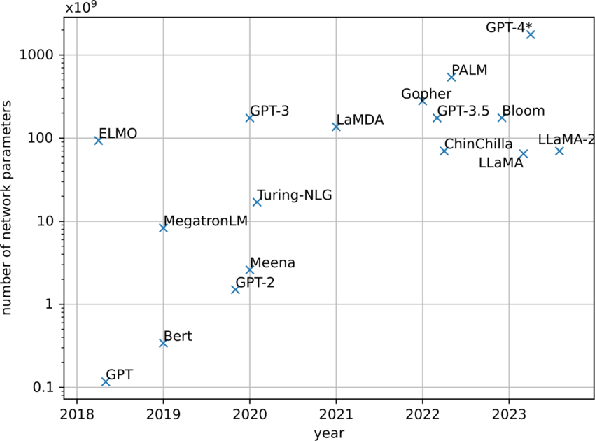
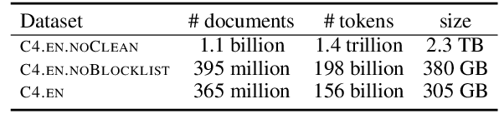
Paper 1: [NeurIPS24’] Scaling data-constrained language models
Background
Scaling LLM: refers to the process of improving model performance and capabilities by increasing the model's parameter size, data size, training time, and computing resources.
The problem this work solved:
Scaling language models in data-constrained regimes
Focus on pre-train language models instead of fine-tuning.
Model
Train transformer language models with GPT-2 architecture.
Model size: 10 million ~ 1.5 billion ~ 8.7 billion.
Dataset
Colossal Clean Crawled Corpus (C4): provides web snapshots.
Training tokens size: 100M~ 900 billion
Metric:
Training loss, test loss, FLOP(Floating Point Operation)
Code: https://github.com/huggingface/datablations.
billion

Slide 56
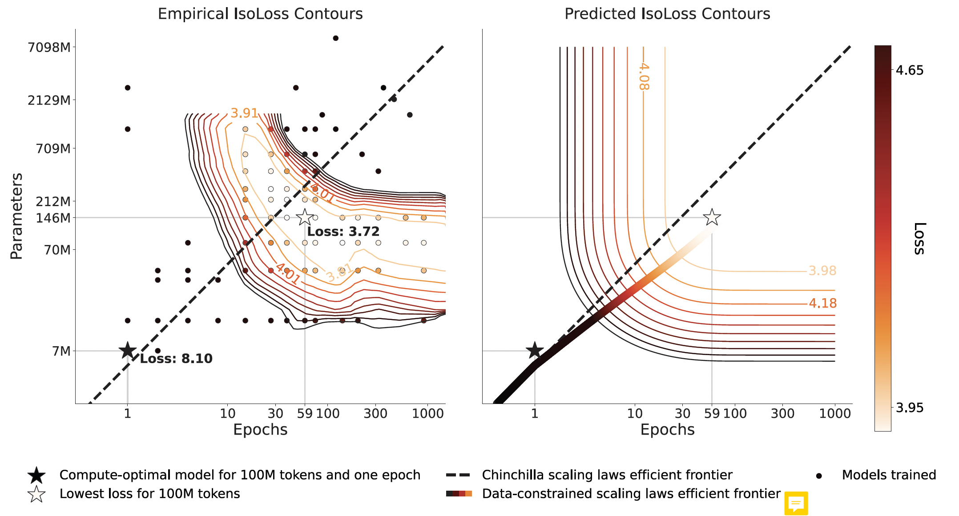
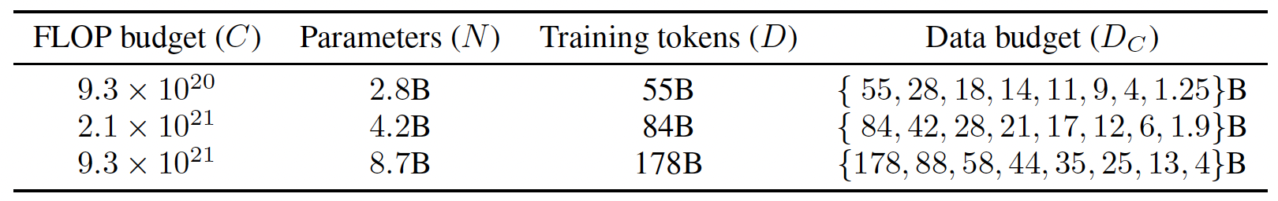
Paper 1: [NeurIPS24’] Scaling data-constrained language models
Exp1: fix the data constraint and train models with varying epochs and parameters.
Evaluate scaling on three training data budgets: 100M, 400M, or 1.5B tokens.
Fix the unique training data 100M, more parameters or more epochs
Fix the unique training data 400M
Fix the unique training data 1.5B
Finding: Adding parameters and epochs causes the loss to decrease and eventually increase again, suggesting that too much computing can hurt performance.
Exp2: fix the computation available (FLOPs) and vary the data size.
Evaluate scaling with three FLOP budgets and eight data budgets

Slide 57
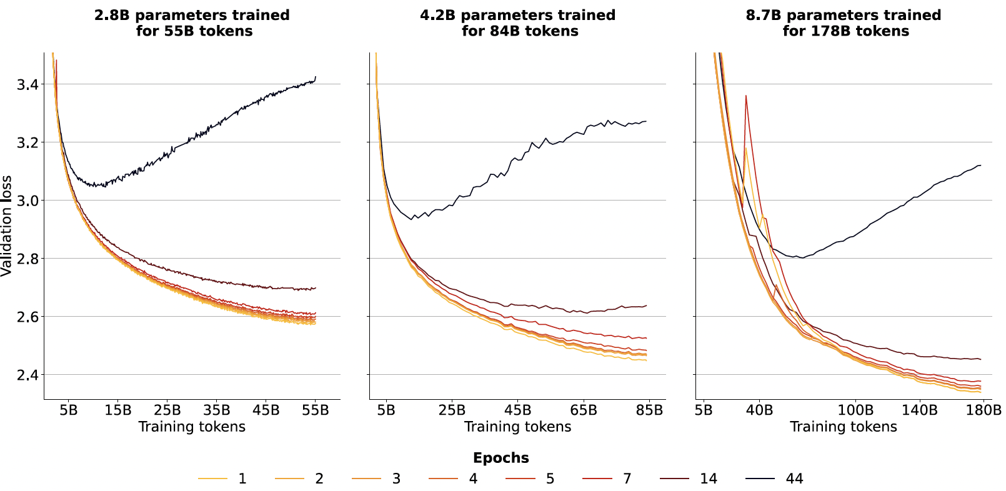
Paper 1: [NeurIPS24’] Scaling data-constrained language models
Exp1: fix the data constraint and train models with varying epochs and parameters.
Evaluate scaling on three training data budgets: 100M, 400M, or 1.5B tokens.
Fix the unique training data 100M, more parameters or more epochs
Fix the unique training data 400M
Fix the unique training data 1.5B
Finding: Adding parameters and epochs causes the loss to decrease and eventually increase again, suggesting that too much computing can hurt performance.
Exp2: fix the computation available (FLOPs) and vary the data size.
Evaluate scaling with three FLOP budgets and eight data budgets
Finding 1: Repeated data is worth less, thus models trained on less unique data (correspondingly more epochs) have consistently higher loss (black line).
Finding 2: Also, the loss difference for a few (such as 4) epochs from single-epoch is negligible.

Slide 58
Paper 1: [NeurIPS24’] Scaling data-constrained language models
Exp1: fix the data constraint and train models with varying epochs and parameters.
Evaluate scaling on three training data budgets: 100M, 400M, or 1.5B tokens.
Fix the unique training data 100M, more parameters or more epochs
Fix the unique training data 400M
Fix the unique training data 1.5B
Finding: Adding parameters and epochs causes the loss to decrease and eventually increase again, suggesting that too much computing can hurt performance.
Exp2: fix the computation available (FLOPs) and vary the data size.
Evaluate scaling with three FLOP budgets and eight data budgets
Finding 1: Repeated data is worth less, thus models trained on less unique data (correspondingly more epochs) have consistently higher loss (black line).
Finding 2: Also, the loss difference for a few (such as 4) epochs from single-epoch is negligible.

Slide 59

Paper 1: [NeurIPS24’] Scaling data-constrained language models
Exp3: Complementary Strategies for Obtaining Additional Data
Goal: improve downstream performance instead of directly minimizing loss.
Approaches mitigating data scarcity:
(a) Code augmentation: use Python code from the Stack dataset to make up for natural language data. The combined dataset consisting of code and natural language samples is shuffled randomly.
(b) Adapting filtering: investigate the performance impact of deduplication and perplexity filtering (high-perplexity data, i.e. low-quality or noisy), two common filtering steps that can severely limit available data. Removing such filtering steps can free up additional training data.
Summary: in a data-constrained regime, recommend reserving filtering for noisy datasets and using both code augmentation and repeating to increase data tokens.

Slide 60

Paper 2: [NeurIPS24’] Repeat or not Repeat: Insights from Scaling LLM under Token-Crisis
Background
LLMs are notoriously token-hungry during pre-training, and high-quality text data on the web is likely to be approaching its scaling limit for LLMs.
To alleviate the token-crisis, one straightforward approach is training LLM by repeating the pre-training data for multiple epochs.
The problem this work solved:
Empirically investigate different aspects of repeat approach for scaling LL in token-crisis regimes.
Focus on pre-train language models instead of fine-tuning.
Model
T5 1.1 architecture: Text-To-Text Transfer Transformer proposed by Google.
Dataset
Colossal Clean Crawled Corpus (C4), Wikipedia
Metric:
MLM (Masked Language Model) accuracy
Exact Match: measures whether the output of a model exactly matches the provided reference answer.
Code: not open.
Notes:
MLM (Masked Language Model) accuracy is a measure of how well a language model, typically based on the transformer architecture, predicts the masked tokens in a given input sequence.

Slide 61


Paper 2: [NeurIPS24’] Repeat or not Repeat: Insights from Scaling LLM under Token-Crisis
Findings
(1) Encoder-Decoder4 model on C4 dataset is comparably data-hungry as stated in Chinchilla scaling law;
Exp1: whether we have a similar data-hungry observation like Chinchilla scaling law?
Model: T5 model
Dataset: C4.
(2) Larger models are more prone to overfitting when training with repeated data.
Exp2: study data, model, and objectives to explore the key factors contributing to multi-epoch degradation.
Dataset size: subsets of the C4 dataset containing approximately $2^{35}$, $2^{29}$, and $2^{27}$ tokens
Repeat times: 1, $2^{6}$ (64), and $2^{8}$ (256).
Model: T5-Base (220 million parameters), T5-Large (770 million), T5-XL (3 billion)

Slide 62


Paper 2: [NeurIPS24’] Repeat or not Repeat: Insights from Scaling LLM under Token-Crisis
Findings
(1) Encoder-Decoder4 model on C4 dataset is comparably data-hungry as stated in Chinchilla scaling law;
Exp1: whether we have a similar data-hungry observation like Chinchilla scaling law?
Model: T5 model
Dataset: C4.
(2) Larger models are more prone to overfitting when training with repeated data.
Exp2: study data, model, and objectives to explore the key factors contributing to multi-epoch degradation.
Dataset size: subsets of the C4 dataset containing approximately $2^{35}$, $2^{29}$, and $2^{27}$ tokens
Repeat times: 1, $2^{6}$ (64), and $2^{8}$ (256).
Model: T5-Base (220 million parameters), T5-Large (770 million), T5-XL (3 billion)
Notes:
Two to the power of six
Two to the power of eight

Slide 63


Paper 2: [NeurIPS24’] Repeat or not Repeat: Insights from Scaling LLM under Token-Crisis
Findings
(3) Training LLM with a larger dataset for multiple epochs can alleviate the multi-epoch degradation;
Exp3: investigate the impact of dataset size and the number of token repeats while keeping the total computation budget fixed.
Repeatedly used $2^{27}$ and $2^{29}$ tokens for 28 times
Observe an overfitting phenomenon when training with $2^{27}$ tokens for 28 epochs (blue line). Model did not experience degradation when using $2^{29}$ tokens for the same number of training steps.
(4) The use of high-quality data does not mitigate multi-epoch degradation.
Exp4: Wikipedia dataset as a high-quality dataset
model trained on Wikipedia exhibits a similar level of degradation to the model trained on C4.

Slide 64

Paper 2: [NeurIPS24’] Repeat or not Repeat: Insights from Scaling LLM under Token-Crisis
Findings
(3) Training LLM with a larger dataset for multiple epochs can alleviate the multi-epoch degradation;
Exp3: investigate the impact of dataset size and the number of token repeats while keeping the total computation budget fixed.
Repeatedly used $2^{27}$ and $2^{29}$ tokens for 28 times
Observe an overfitting phenomenon when training with $2^{27}$ tokens for 28 epochs (blue line). Model did not experience degradation when using $2^{29}$ tokens for the same number of training steps.
(4) The use of high-quality data does not mitigate multi-epoch degradation.
Exp4: Wikipedia dataset as a high-quality dataset
model trained on Wikipedia exhibits a similar level of degradation to the model trained on C4.

Slide 65

Paper 2: [NeurIPS24’] Repeat or not Repeat: Insights from Scaling LLM under Token-Crisis
Findings
(5) The number of parameters plays a crucial role in multi-epoch degradation, even when the computation budget is fixed. The effect of FLOPs on this issue is negligible;
Exp3: disentangle the effects of Parameters and FLOPs, introduce Mixture-of-Experts (MoE) and parameter sharing (ParamShare) to change parameters with comparable computation cost.
In Figure a, model with less parameters is less influenced by the usage of repeated tokens (gap between same color)
In Figure b, although the model with more computation achieves slightly better performance when scaling the FLOPs alone, do not observe a clear increase in degradation.

Slide 66



Paper 2: [NeurIPS24’] Repeat or not Repeat: Insights from Scaling LLM under Token-Crisis
Findings
(6) Using dropout alone is highly effective in alleviating the multi-epoch degradation.
Exp: investigate whether existing regularization technologies can alleviate multi-epoch degradation.
Adding additional regularizations on top of dropout does not lead to further performance improvements

Slide 67


Outline
Problems
Meta-Learning for Robustness
Definition of meta-learning
Optimization approaches for meta-training
Data-constraint LLM Learning
Designed for pre-training or fine-tuning
Transferability-based Adversarial Attack
Attack technique against surrogate model
Attacks and Defenses of LLM
Attacks on LLM
Robustness as meta-objective
Dataset size used for training
No training time cost analysis provided
LLM? Model size
Robustness of black-box model
Robustness of surrogate model
Defense of LLM

Slide 68
May 21, 2023
Transferability-based Adversarial Attack
SOTA Work

Slide 69



Paper 1: [S&P24’] Why Does Little Robustness Help? Adversarial Transferability
Background
Transferability of adversarial examples for DNNs:
Examples that successfully fool one white-box surrogate model can also deceive other black-box models with different architectures.
Approaches to improve transferability
Find transferable AEs under given surrogate models by proposing complex tricks to be incorporated into the generation pipeline
Integrate momentum to smooth the gradient update during the adversarial sample generation process, thereby reducing the instability of the gradient during the generation.
Apply transformations at each iteration to create diverse input patterns
Examine the role of surrogate models
surrogate
Shortcoming:
computational expenses
low scalability
This work
produce better surrogate models to launch stronger transfer attacks.

Slide 70



Paper 1: [S&P24’] Why Does Little Robustness Help? Adversarial Transferability
Problems this work solved
Interpretability of transferable adversarial examples
Focus on the joint effects of model smoothness and gradient similarity on transferability.
Key definition
Model Smoothness: captures the general invariance of the gradient w.r.t. input features for a given model.
Data augmentation: Use Mixup (MU), Cutmix (CM), Cutout (CO), and Label smoothing (LS) to investigate how these different kinds of distribution shifts affect the gradient similarity.
Gradient regularization input gradient regularization (IR), input Jacobian regu- larization (JR) in the input space, explicit gradient reg- ularization (ER), sharpness-aware minimization (SAM) in the weight space.
Notes:
dominant eigenvalue: 显性特征值， 指的是Hessian矩阵的最大和最小特征值，
Eigenvalue : /ˈīɡənˌvalyo͞o/ 特征值
大正特征值表明该方向上的变化非常敏感。
负特征值表明该方向上存在凹陷，可能存在鞍点或局部极小值。

Slide 71

Paper 1: [S&P24’] Why Does Little Robustness Help? Adversarial Transferability
Problems this work solved
Interpretability of transferable adversarial examples
Focus on the joint effects of model smoothness and gradient similarity on transferability.
Key definition
Model Smoothness: captures the general invariance of the gradient w.r.t. input features for a given model.
Gradient Similarity: refers to the alignment of the gradient direction between surrogate and target models.
denote the surrogate model as$ℱ$, target model as $𝒢$
Data augmentation: Use Mixup (MU), Cutmix (CM), Cutout (CO), and Label smoothing (LS) to investigate how these different kinds of distribution shifts affect the gradient similarity.
Gradient regularization input gradient regularization (IR), input Jacobian regu- larization (JR) in the input space, explicit gradient reg- ularization (ER), sharpness-aware minimization (SAM) in the weight space.

Slide 72
Paper 1: [S&P24’] Why Does Little Robustness Help? Adversarial Transferability
Problems this work solved
Interpretability of transferable adversarial examples
Focus on the joint effects of model smoothness and gradient similarity on transferability.
Key definition
Model Smoothness: captures the general invariance of the gradient w.r.t. input features for a given model.
Gradient Similarity: refers to the alignment of the gradient direction between surrogate and target models.
Little robustness phenomenon: models adversarially trained with small perturbed adversarial samples serve as better surrogates for transfer attacks (than larger perturbation budget).
Data augmentation: Use Mixup (MU), Cutmix (CM), Cutout (CO), and Label smoothing (LS) to investigate how these different kinds of distribution shifts affect the gradient similarity.
Gradient regularization input gradient regularization (IR), input Jacobian regu- larization (JR) in the input space, explicit gradient reg- ularization (ER), sharpness-aware minimization (SAM) in the weight space.

Slide 73
Paper 1: [S&P24’] Why Does Little Robustness Help? Adversarial Transferability
Findings
Verifying the “little robustness” phenomenon.
Data distribution shift impair gradient similarity.
Distribution shifts unanimously impair gradient similarity in different levels, and the degradation generally aligns with the augmentation magnitude.
Augmentations affect smoothness differently.
Despite their different trade-off effects, they consistently yield worse transferability.
Gradient regularization improve model smoothness.
Regularizations in the input space (IR,JR) leading to faster and more stable improvement than regularizations in the weight space(SAM).
IR,JR do not necessarily outperform SAM in terms of transferability.
Data augmentation: Use Mixup (MU), Cutmix (CM), Cutout (CO), and Label smoothing (LS) to investigate how these different kinds of distribution shifts affect the gradient similarity.
Gradient regularization input gradient regularization (IR), input Jacobian regu- larization (JR) in the input space, explicit gradient reg- ularization (ER), sharpness-aware minimization (SAM) in the weight space.

Slide 74
Paper 1: [S&P24’] Why Does Little Robustness Help? Adversarial Transferability
Findings
A general route for the adversary to obtain surrogates with both superior smoothness and similarity:
First, assessing the smoothness of different training mechanisms and comparing their similarities
Then, developing generally effective strategies by combining the best elements of each.
Input regularization and SAM excel at promoting smoothness and similarity, respectively, as well as other complementary properties.
Propose SAM&JR and SAM&IR to obtain better surrogates.
Data augmentation: Use Mixup (MU), Cutmix (CM), Cutout (CO), and Label smoothing (LS) to investigate how these different kinds of distribution shifts affect the gradient similarity.
Gradient regularization input gradient regularization (IR), input Jacobian regu- larization (JR) in the input space, explicit gradient reg- ularization (ER), sharpness-aware minimization (SAM) in the weight space.

Slide 75
Paper 1: [S&P24’] Why Does Little Robustness Help? Adversarial Transferability
Main Work
Hypothesize that the data distribution shift induced by off-manifold samples (PGD) in adversarial training is the reason that impairs gradient similarity.
Explore the impacts of data augmentation (affect gradient similarity) and gradient regularization (affect model smoothness) on transferability.
Analyze how the trade-off is reflected in various training methods
Provide a general route for constructing superior surrogates to boost transferability
Optimizes both model smoothness and gradient similarity simultaneously, e.g., the combination of input gradient regularization and sharpness-aware minimization (SAM).
Data augmentation: Use Mixup (MU), Cutmix (CM), Cutout (CO), and Label smoothing (LS) to investigate how these different kinds of distribution shifts affect the gradient similarity.
Gradient regularization input gradient regularization (IR), input Jacobian regu- larization (JR) in the input space, explicit gradient reg- ularization (ER), sharpness-aware minimization (SAM) in the weight space.

Slide 76

Paper 1: [S&P24’] Why Does Little Robustness Help? Adversarial Transferability
Compared Summary with Previous Work
USENIX19’
S&P22’
UAI23’
ECCV22’
NeurIPS22’
ICLR22’
USENIX19’
ICLRW18’
ICLR23’
ICLR23’
Notes:
proposed constructing the ensemble from a large geometric vicinity (LGV), i.e., first fine-tuning a normally trained model with a high constant learning rate to obtain a set of intermediate models that belongs to a large vicinity, then optimizing AEs iteratively against all these models.

Slide 77

Paper 1: [S&P24’] Why Does Little Robustness Help? Adversarial Transferability
Some experimental results

Slide 78


Paper 1: [S&P24’] Why Does Little Robustness Help? Adversarial Transferability
Some experimental results

Slide 79

Outline
Problems
Meta-Learning for Robustness
Definition of meta-learning
Optimization approaches for meta-training
Data-constraint LLM Learning
Designed for pre-training or fine-tuning
Transferability-based Adversarial Attack
Attack technique against surrogate model
Attacks and Defenses of LLM
Attacks on LLM
Robustness as meta-objective
Dataset size used for training
No training time cost analysis provided
LLM? Model size
Robustness of black-box model
Robustness of surrogate model
Defense of LLM

Slide 80
May 21, 2023
Attacks and Defenses of LLM
Background and Related Work

Slide 81
Paper 1: [NeurIPS23’] A Comprehensive Assessment of Trustworthiness in GPT Models
Problems this work solved
Provide a thorough assessment of trustworthiness in GPT models.
Toxicity: model's tendency to generate harmful or inappropriate content. This content may include offensive speech, hate speech, violent speech, etc.
Stereotype bias: models may reflect stereotypes and biases in society when generating text.
Adversarial robustness: the stability of the model in the face of adversarial attacks
adversarial prompts
adversarial demonstrations
Out-of-distribution robustness: model's performance when handling new data that falls outside the distribution of the training data.
Privacy: ability to protect user privacy when processing user data.
Machine ethics: model's ability to adhere to ethical and moral guidelines when generating content
Fairness: ability of a model to generate content without favoring any particular group or individual.
Discover previously unpublished vulnerabilities to trustworthiness threats.
GPT-4 is more vulnerable given jailbreaking system or user prompts, potentially because GPT-4 follows (misleading) instructions more precisely.
Notes:
包括毒性、刻板印象偏见、对抗鲁棒性、分布外鲁棒性、对抗性演示的鲁棒性、隐私、机器道德和公平性。

Slide 82

Paper 1: [NeurIPS23’] A Comprehensive Assessment of Trustworthiness in GPT Models
Robustness-related case

Slide 83
Paper 1: [NeurIPS23’] A Comprehensive Assessment of Trustworthiness in GPT Models
Models
GPT 3.5, GPT 4
Findings:
Adversarial robustness
GPT-4 surpasses GPT-3.5 on the standard AdvGLUE benchmark, demonstrating higher robustness;
AdvGLUE dataset: a multi-task benchmark designed to evaluate the vulnerabilities of large-scale language models.
Including 14 adversarial text generation strategies against BERT-like models on GLUE tasks.
Model robustness to word-level changes: word-level perturbations along with human-crafted perturbations.
Model robustness to sentence-level changes: sentence-level perturbations along with human-crafted perturbations.
GPT-4 is more resistant to human-crafted adversarial texts compared to GPT-3.5;
attack success rate of ANLI and AdvSQuAD dropped from 61.13% to 36.78% and from 10.52% to 0% on GPT-4.
Adversarial GLUE: A multi-task benchmark for robustness evaluation of language models.NeurIPS, 2021,

Slide 84
Paper 1: [NeurIPS23’] A Comprehensive Assessment of Trustworthiness in GPT Models
Models
GPT 3.5, GPT 4
Findings:
Adversarial robustness
GPT models, despite their strong performance on standard benchmarks, are still vulnerable to our adversarial attacks generated based on the Alpaca-7B model (e.g., SemAttack achieves 89.2% attack success rate on GPT-4);
Among attacks on Alpaca-7B model, SemAttack and BERT-Attack are the most transferable ones to GPT-3.5 and GPT-4, respectively.
sentence-level and human-crafted perturbations are more effective than word-level perturbations when transferring the adversarial texts from BERT-like models.
For GPT-4, sentence-level perturbation strategies are more effective than other strategies, while human-crafted perturbations and sentence-level perturbations are both effective for GPT-3.
Code: https://decodingtrust.github.io/
Adversarial GLUE: A multi-task benchmark for robustness evaluation of language models.NeurIPS, 2021,

Slide 85

Paper 1: [NeurIPS23’] A Comprehensive Assessment of Trustworthiness in GPT Models
AdvGLUE test set with different attacks
TB: TextBugger, TF: TextFooler, BA: BERT-ATTACK, SPSO: SememePSO, SA: SemAttack,
T3: Tree-Autoencoder Constrained Adversarial Text, AF: AdvFever, ST: StressTest (s), CL: CheckList (s),
ANLI: Adversarial Natural Language Inference, AS: AdvSQuAD, ST: StressTest (h), CL: CheckList (h) ,
s: Sentence-level, h: Human-crafted
Adversarial GLUE: A multi-task benchmark for robustness evaluation of language models.NeurIPS, 2021,

Slide 86



Paper 2: Certifying LLM Safety against Adversarial Prompting (arXiv2023)
LLMama2

Slide 87



Paper 2: Certifying LLM Safety against Adversarial Prompting (arXiv2023)
LLMama2

Slide 88

Outline
Problems
Meta-Learning for Robustness
Definition of meta-learning
Optimization approaches for meta-training
Data-constraint LLM Learning
Designed for pre-training or fine-tuning
Transferability-based Adversarial Attack
Attack technique against surrogate model
Attacks and Defenses of LLM
Attacks on LLM
Robustness as meta-objective
Dataset size used for training
No training time cost analysis provided
LLM? Model size
Robustness of black-box model
Robustness of surrogate model
Defense of LLM

